Slide 1
Reptile Breeding Facility
Real life example O2-B-2
Notes:
Please give a name to your story ☺

Slide 2
About this document
This document is a real life example illustrating importance of the values of academic integrity in professional life.
It was created as a part of Toolkit for cross-sector cooperation in terms of academic integrity within Erasmus+ project.
It is a ready-to-use case study accompanied with didactic notes and discussion questions and/or other tasks for the audience.
Find more case studies in ENAI database of educational materials.

Slide 3
Basic information
Target audience: pupils, participants of professional training (preferably, but not necessary in biology/work with animals)
Summary: missing important part of the education due to cheating causing fail in professional life
Objective: become conscious possible consequences of missing some skill and knowledge which are important in the given profession
Length: 10 minutes

Slide 4
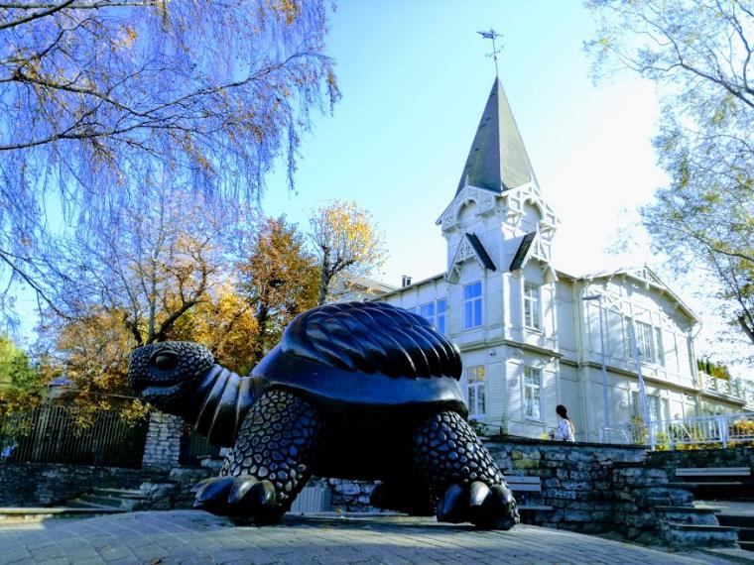
Janice enjoyed most of her job working for a reptile-breeding facility, especially the snakes and lizards, but during training, she was quite bored, and did not pay attention, to the trainings regarding the (slow, sluggish) turtles.
She simply obtained the answers to the tests on the turtle section from a friend who had taken the test the year before.
Notes:
Photo by: Dita Dlabolová

Slide 5
When spring arrived and the facility became busy,
she cared for the turtles just as she did for the
lizards and snakes, not realizing that the sex of hatching turtles is determined by the temperature at which they incubate.
Subsequently, every one of the year's turtle hatchlings were born male—which meant that the reptile facility was unable to fill any orders for sexed pairs of turtles.

Slide 6

What can be the consequences for the facility?
What did Janice supervisor do when he realized that Janice did not varied the temperature?
Notes:
Place for student discussion: let them brainstorm about possible outcomes and discuss about the possible reaction of the supervisor.

Slide 7
The end
When her supervisor realized that she had not varied the temperature, Janice was terminated and her last paychecks were withheld to cover part of the damages.
Notes:
You can show this slide to the students, or you can skip it and work with the conclusion provided by the students.

Slide 8
Questions for discussions for students
What was the cause of the problem?
What could have been done to prevent it?
How could the trainer motivate students who are not interested in turtles?

Slide 9
Message of the Story
Even when some parts of education are boring for you and seem not to be interesting, they might be very crucial for practice.

Slide 10
Author & Contact Information
Story by: Teddi Fishman (teddifish@gmail.com)
Adapted by: Dita Dlabolová (dita.dlabolova@mendelu.cz)

Slide 11

License Information
Title of the work: Reptile Breeding Facility
Attribute work to name: Teddi Fishman & Dita Dlabolová
Licensed under: creativecommons.org/licenses/by/4.0
Attribute using following text:
Reptile Breeding Facility by Teddi Fishman & Dita Dlabolová
is licensed under a Creative Commons Attribution 4.0 International License.

