Slide 1
Where is the borderline of plagiarism?
Plagiarism vs. Good Citation Practices

Slide 2
Acknowledgement of Authors
EU funded project “Impact of Policies for Plagiarism in Higher Education across Europe”
Irene Glendinning, Coventry University, UK
Tomáš Foltýnek, Mendel University in Brno, Czechia
Dita Dlabolová, Mendel University in Brno, Czechia
Ansgar Schäfer, University of Konstanz, Germany

Slide 3
Structure of the Workshop
Examples of plagiarism
Definitions of plagiarism
Where is the borderline? Judgment of cases
Reasons for plagiarism
Prevention of plagiarism
Discussion

Slide 4
Example no. 1 (MENDELU, 2017)

Slide 5
Example no. 1 (MENDELU, 2017)

Slide 6
Example no. 1 (MENDELU, 2017)

Slide 7
Example no. 2 (MENDELU, 2017)

Slide 8
Definition of Plagiarism
What do you understand by plagiarism?
Write down your definition to the chat

Slide 9
Definition
What do you understand by plagiarism?
the use of ideas, content, or structures
without appropriately acknowledging the source
to benefit in a setting where originality is expected
Published in: Foltýnek, T., Meuschke, N., & Gipp, B. (2019). Academic Plagiarism Detection: A Systematic Literature Review. ACM Comput. Surv., 52(6), 112:1--112:42. https://doi.org/10.1145/3345317
Based on:
Meuschke, N., & Gipp, B. (2013). State-of-the-art in detecting academic plagiarism. International Journal for Educational Integrity, 9(1): 50-57
Fishman, T. (2009). ‘We Know It When We See It’ Is Not Good Enough: Toward a Standard Definition of Plagiarism That Transcends Theft, Fraud, and Copyright. In Proceedings 4th Asia Pacific Conference on Educational Integrity (4APCEI), 5, 2009.

Slide 10
Plagiarism includes…
Using the work of someone else and presenting it as your own
Presenting translation or paraphrase of another work as original
Using your own previously published work without proper acknowledgement
Failing to correctly cite and reference another source
Not giving due credit for the contribution of someone else to your work

Slide 11
What is NOT plagiarism
You don’t have to provide the source of
General knowledge
General knowledge of your field
Someone else’s contribution not influencing content
Proofreading
Typographic corrections
Formatting

Slide 12
Why should we deal with it?
Why should be universities interested
in addressing plagiarism?

Slide 13
Where is the borderline?
We will go through 8 scenarios
In each scenario, 40 % of student work is taken from other sources
For each case, decide whether you consider it
Serious plagiarism
Plagiarism
Not sure
Not plagiarism

Slide 14
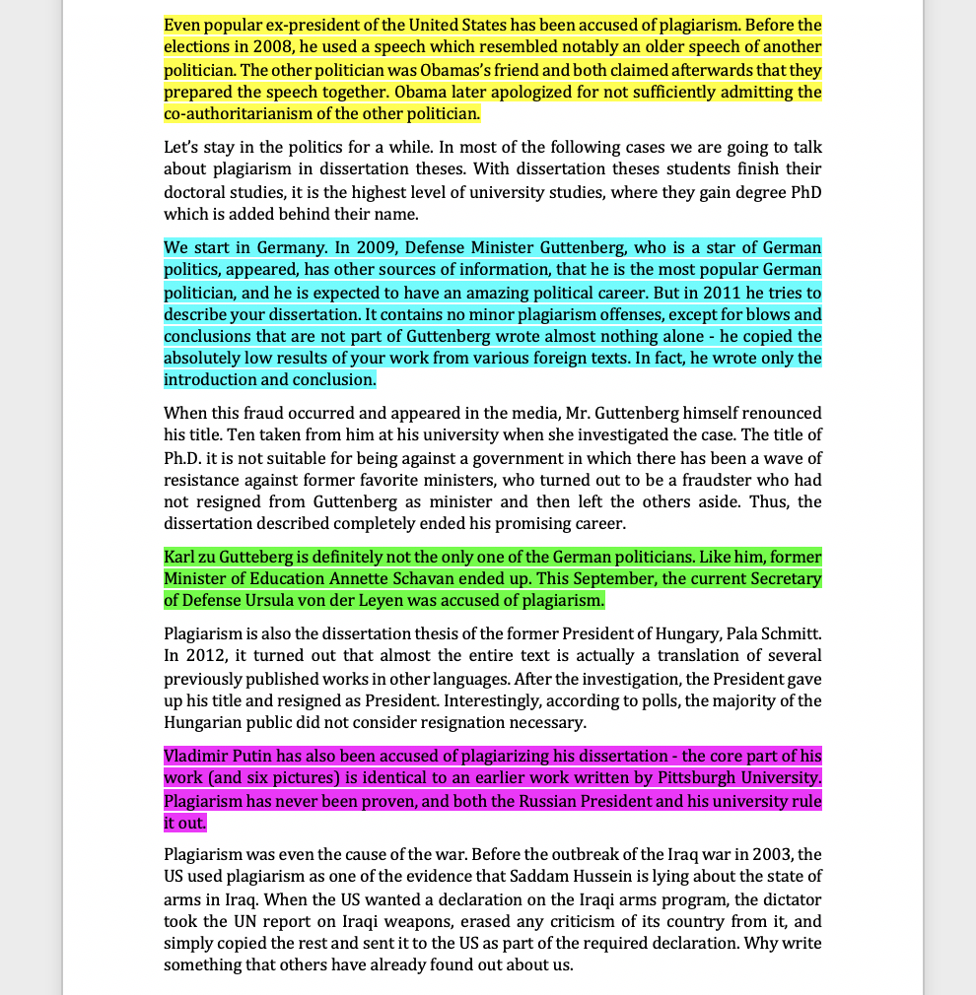
Scenario no. 1
40 %

Slide 15
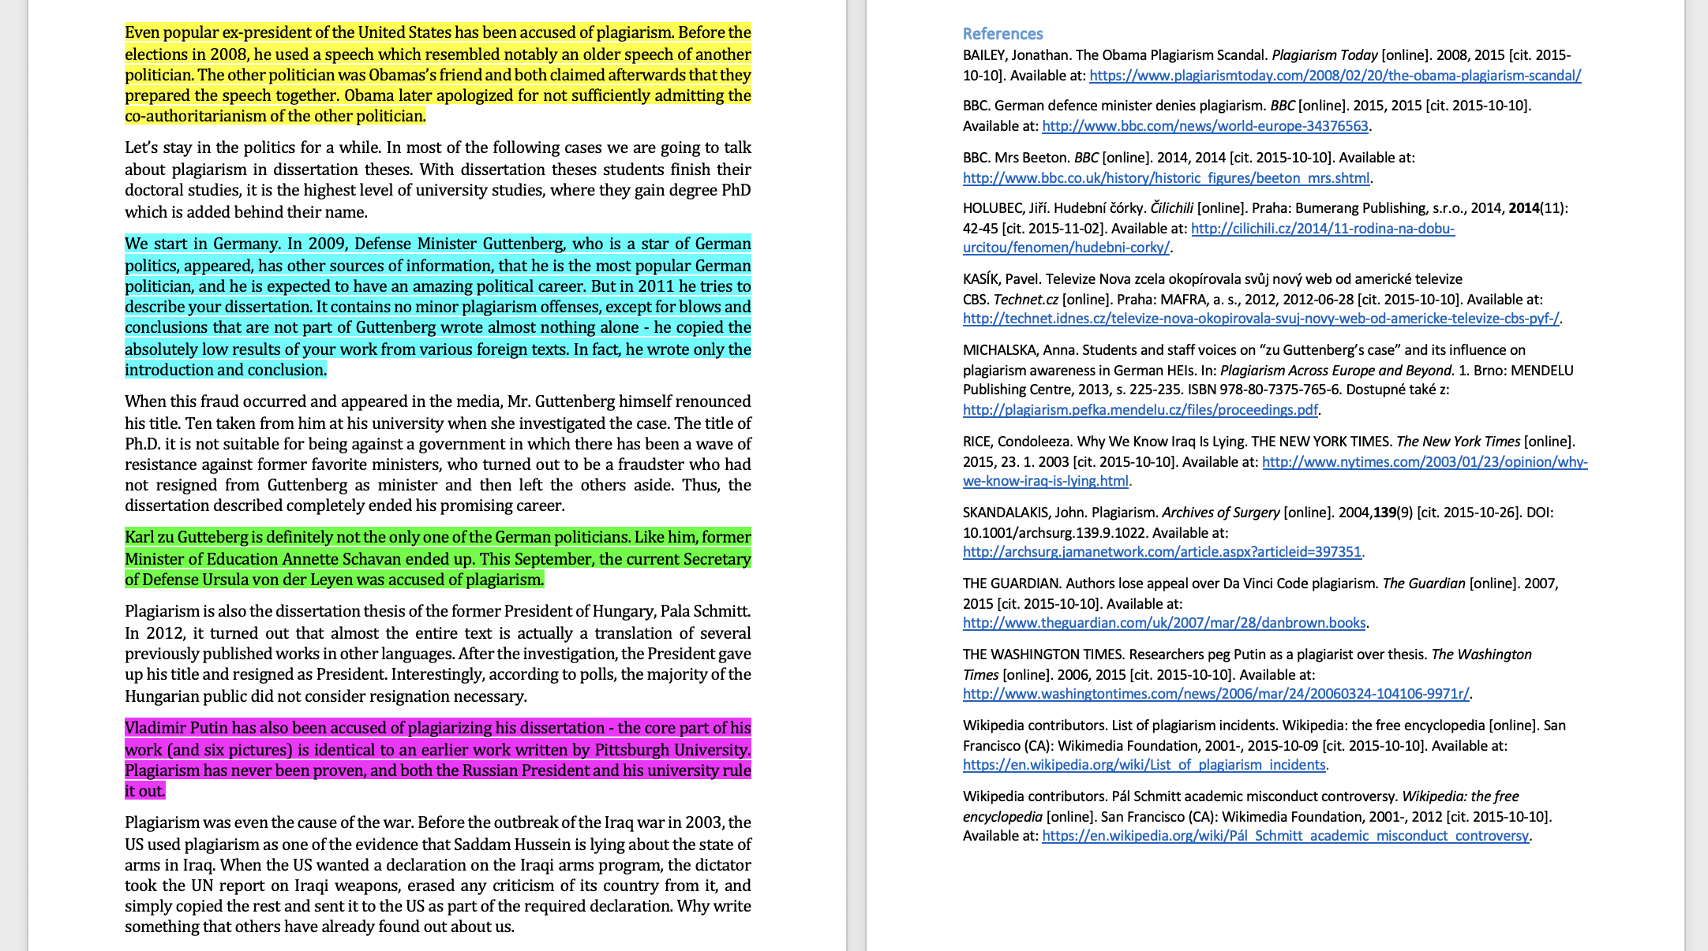
Scenario no. 2
40 %

Slide 16
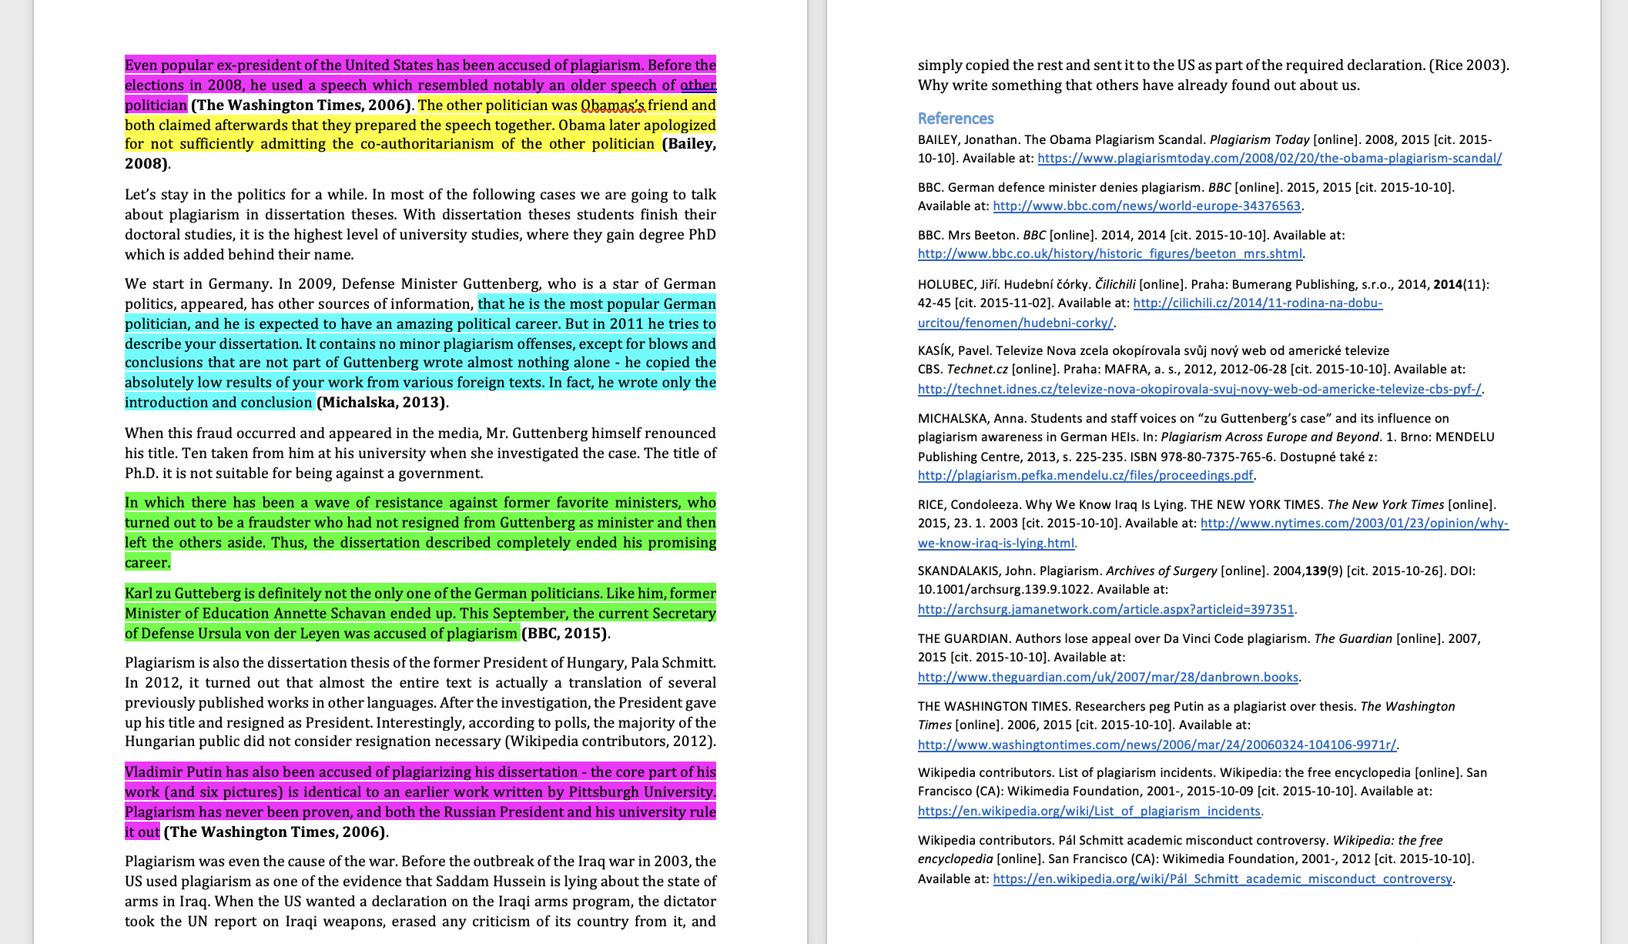
Scenario no. 3
40 %

Slide 17
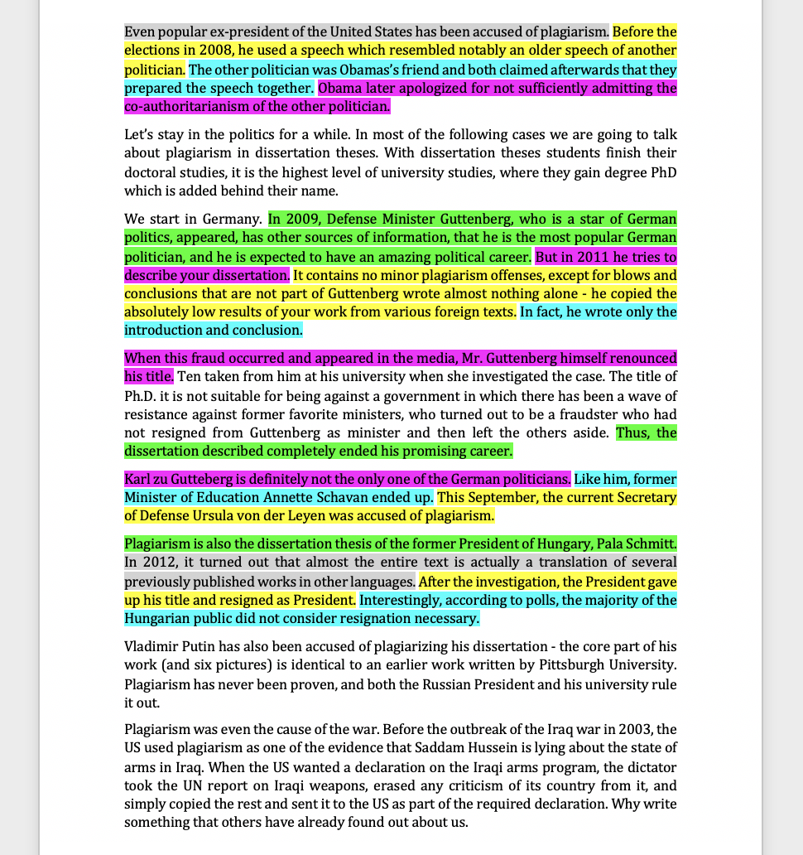
Scenario no. 4
40 %

Slide 18
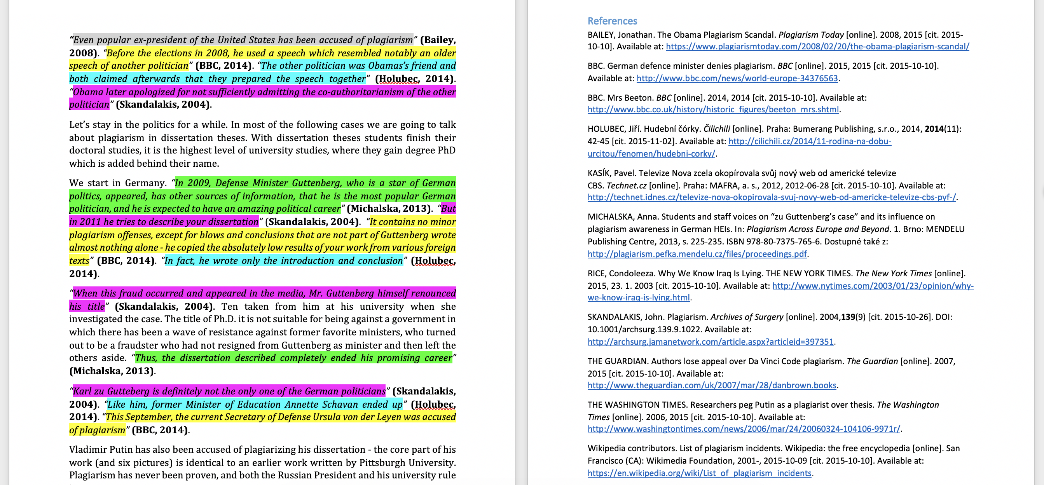
Scenario no. 5
40 %

Slide 19
Some words changed (6, 7, 8)
Student’s submission
The original source
40 %
Notes:
Source of the text: https://en.wikipedia.org/wiki/Plagiarism

Slide 20
What Do You Think?
 | 40 % of a student work is taken from other sources…
1 | word for word with no quotations, no references and no in-text citations
2 | word for word with no quotations, has references, no in-text citations
3 | word for word with no quotations, has references and in-text citations
4 | consisting of many short phrases throughout from many sources with no quotations, no references or in-text citations
5 | consisting of many short phrases throughout from many sources with quotations, references and in-text citations
6 | some words changed with no quotations, no references and no in-text citations
7 | some words changed with no quotations, has references, no in-text citations
8 | some words changed with no quotations, has references and in-text citations

Slide 21
Voting
Go to www.kahoot.it
Enter code

Slide 22
Scenario no. 1
40 %

Slide 23
Scenario no. 2
40 %

Slide 24
Scenario no. 3
40 %

Slide 25
Example from Mr. Apple‘s blog:
Ms. Carrot says about Mr. Lemon: Mr. Lemon is yellow. She also adds about him that he is a citrus. Then Ms. Carrot mentioned that Mr. Lemon is sour. And he is also salty. Ms. Carrot also revealed a very surprising fact that Mr. Lemon grows on trees!

Slide 26
Example from Mr. Apple‘s blog:
Ms. Carrot says about Mr. Lemon: Mr. Lemon is yellow. She also adds about him that he is a citrus. Then Ms. Carrot mentioned that Mr. Lemon is sour. And he is also salty. Ms. Carrot also revealed a very surprising fact that Mr. Lemon grows on trees!

Slide 27
Example from Mr. Apple‘s blog:
Ms. Carrot says about Mr. Lemon: Mr. Lemon is yellow. She also adds about him that he is a citrus. Then Ms. Carrot mentioned that Mr. Lemon is sour. And he is also salty. Ms. Carrot also revealed a very surprising fact that Mr. Lemon grows on trees!

Slide 28
Scenario no. 4
40 %

Slide 29
Scenario no. 5
40 %

Slide 30
Some words changed (6, 7, 8)
Student’s submission
The original source
40 %
Notes:
Source of the text: https://en.wikipedia.org/wiki/Plagiarism

Slide 31
Where is the borderline?
Focus on scenarios 1 and 6
Which of them is worse?
What do European students think about these cases?

Slide 32
40% of student’s work copied word for word with no quotation, references or citations (1)
Sources: IPPHEAE 2013, SEEPPAI 2018

Slide 33
40% of student’s work copied, some words changed, no quotations, ref. or citations (6)
Sources: IPPHEAE 2013, SEEPPAI 2018

Slide 34
Looking for reasons
Why do students plagiarise?
Write down as many reasons as you can think of

Slide 35
Students vs. teachers: Why do students plagiarize?
Teachers
it’s easy to cut and paste
plagiarism is not wrong
lecturer will not care
Students
run out of time
unable to cope with the workload
their own work is not good enough

Slide 36
Students vs. teachers
How students get to know about plagiarism?
Teachers: Class/workshop
Students: Web pages
What is difficult on academic writing?
Teachers: Referencing formats, citing and referencing
Students: Finding good sources, paraphrasing

Slide 37
Students vs. teachers, scenarios 6, 7, 8: 40% copied, some words changed. Is it plagiarism?
Source: IPPHEAE 2013

Slide 38
How Can We Prevent Plagiarism?
Write down your ideas to chat

Slide 39
How Can We Prevent Plagiarism?
consistent approach
policies
clear instructions for students
awareness of consequences
training for staff
education and support for students
Notes:
45
Do students understand your expectations?
Training, guidance and support for students.
Testing to see whether students understand
Awareness of consequences and penalties
Staff training and development
Consistent approach and actions by staff
Use of tools – policy, training
What more could be done?

Slide 40
Prevention: Systemic Effort Works
Curtis & Vardanega, 2016
Owens & White, 2013
10-years study (2004-2014)
New course Academic writing
Started using Turnitin
Introduced criterion and standards-based assessment
Implemented educational changes
All forms of plagiarism DECREASED
except recycling and ghostwriting
5-years study (2007-2011)
PD SW as both deterrent and formative tool
Educational about academic writing and authorship
Self-reported plagiarism DROPPED significantly
Nature of assessment has a central role
Curtis, G. J., & Vardanega, L. (2016). Is plagiarism changing over time? A 10-year time-lag study with three points of measurement. Higher Education Research & Development, 35(6), 1167–1179. https://doi.org/10.1080/07294360.2016.1161602
Owens, C., & White, F. A. (2013). A 5‐year systematic strategy to reduce plagiarism among first‐year psychology university students. Australian Journal of Psychology, 65(1), 14–21. https://doi.org/10.1111/ajpy.12005

Slide 41
Percentages are tricky!
Diploma thesis, Czechia
Overall similarity: 24%
Student copied whole thesis, but paraphrased the text
Percentage corresponds to text-matching only
Student assignment, Australia
Overall similarity: 8%
Whole abstract highlighted and linked to an essay mill
Rest of the essay behind the pay-wall
Diploma thesis, Georgia
Overall similarity: 7%
Whole list of references
Rest of the thesis translated from Russian to Georgian
Bachelor thesis, Czechia
Overall similarity: 89%
Source: Previous version of the same thesis
%

Slide 42
Sources & Further Reading
Curtis, G. J., & Vardanega, L. (2016). Is plagiarism changing over time? A 10-year time-lag study with three points of measurement. Higher Education Research & Development, 35(6), 1167–1179. https://doi.org/10.1080/07294360.2016.1161602
Foltýnek, T., Dlabolová, D., Anohina-Naumeca, A., Razı, S., Kravjar, J., Kamzola, L., … Weber-Wulff, D. (2020). Testing of support tools for plagiarism detection. International Journal of Educational Technology in Higher Education, 17(1), 46. https://doi.org/10.1186/s41239-020-00192-4
Foltýnek, T., Meuschke, N., & Gipp, B. (2019). Academic Plagiarism Detection: A Systematic Literature Review. ACM Comput. Surv., 52(6), 112:1--112:42. https://doi.org/10.1145/3345317
Impact of Policies for Plagiarism in Higher Education across Europe (IPPHEAE) – projekt LLP/Erasmus, 2010—2013: www.plagiarism.cz/ippheae
Owens, C., & White, F. A. (2013). A 5‐year systematic strategy to reduce plagiarism among first‐year psychology university students. Australian Journal of Psychology, 65(1), 14–21. https://doi.org/10.1111/ajpy.12005
Meuschke, N., & Gipp, B. (2013). State-of-the-art in detecting academic plagiarism. International Journal for Educational Integrity, 9(1): 50-57
Fishman, T. (2009). ‘We Know It When We See It’ Is Not Good Enough: Toward a Standard Definition of Plagiarism That Transcends Theft, Fraud, and Copyright. In Proceedings 4th Asia Pacific Conference on Educational Integrity (4APCEI), 5, 2009.
South East European Project on Policies for Academic Integrity (SEEPPAI) – 2016—2017: www.plagiarism.cz/seeppai

Slide 43
Contacts
tomas.foltynek@academicintegrity.eu
dita.dlabolova@academicintegrity.eu
www.academicintegrity.eu
www.plagiarism.cz

Slide 44
License Information
Title of the work: Where is the borderline of plagiarism?
Attribute work to names: Glendinning, I., Foltýnek, T., Dlabolová, D., Schäfer, A.
Licensed under: Creative Commons Attribution-ShareAlike 4.0 International License
Attribute using following text:
Where is the borderline of plagiarism?
by Glendinning, I., Foltýnek, T., Dlabolová, D., Schäfer, A. is licensed under a Creative Commons Attribution-ShareAlike 4.0 International License.

