Slide 1
Copyright in teacher‘s work
Using of others sources and sharing our own with Creative Commons

Slide 2
Motivation
I want to use correctly sources created by other authors.
I want to easily share my work with the other people.
Notes:
Optional part

Slide 3
Authorship
Every piece of work has an author.
Copyright in general protects rights of authors.
Different licenses with different conditions are used to deal with the copyright.

Slide 4
Imagine you need to use a picture of city of Riga in your materials…
What will you do?

Slide 5
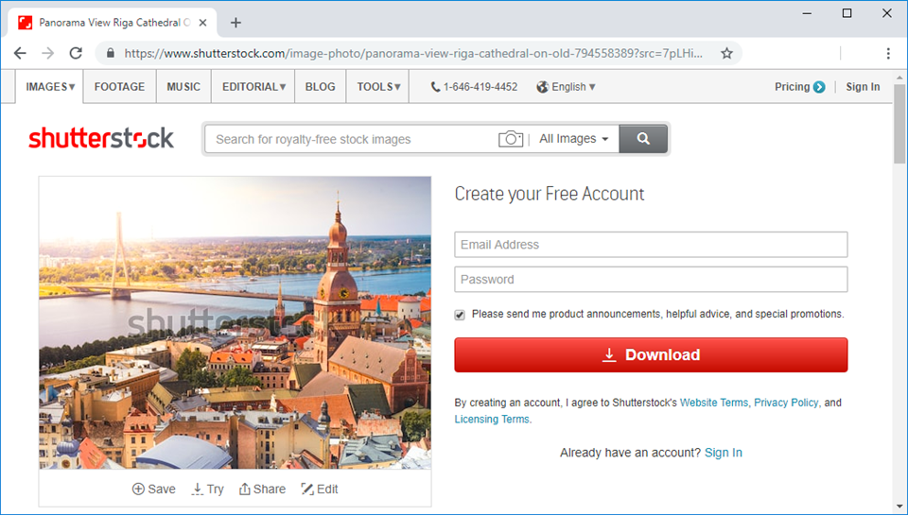
Notes:
Explanatory notes for this slide:
You probably search with Google and you might find for example this beautiful image…

Slide 6
Can you just download the image and use it?

Slide 7
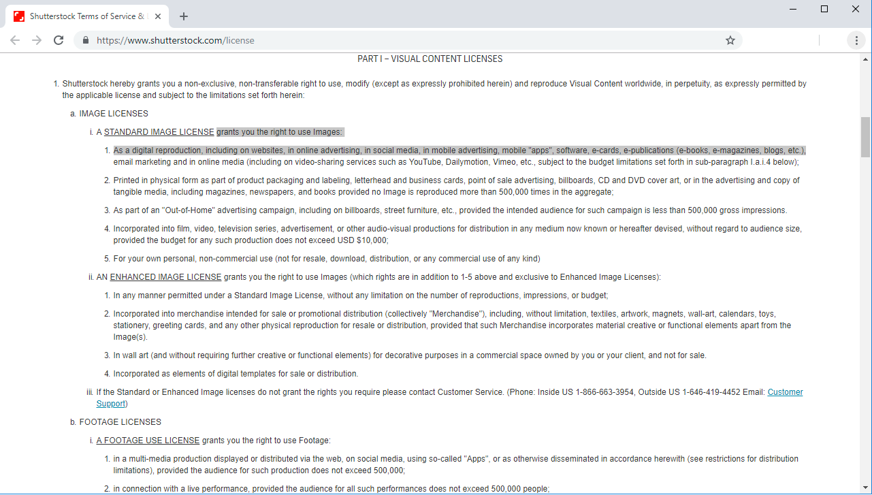
Notes:
As this image was found on Shutterstock database, you should use it only following the given conditions.
We can see here they are pretty complicated…

Slide 8
So you continue searching…

Slide 9
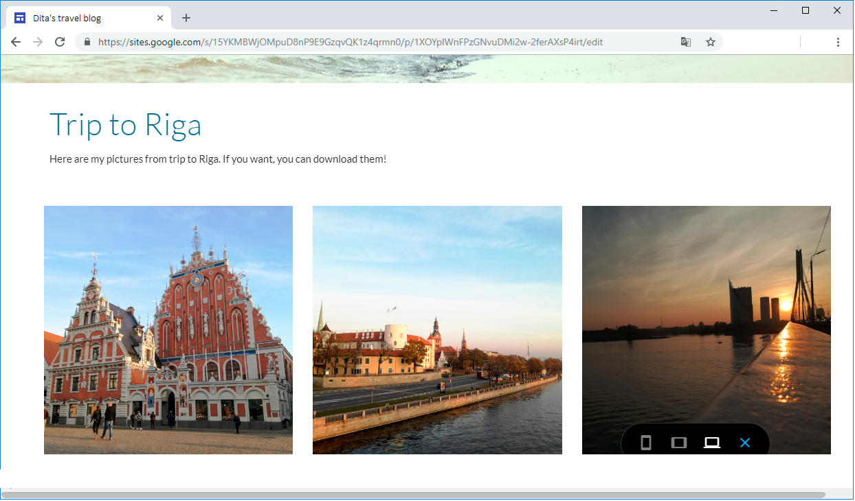
Notes:
… and you find for example this blog, where the author claims everybody can use the pictures… but is it true? Under

Slide 10
What are the conditions?
Can I really use it?
How to contribute the author?
awareness of consequences
training for staff
education and support for students
Notes:
45
Do students understand your expectations?
Training, guidance and support for students.
Testing to see whether students understand
Awareness of consequences and penalties
Staff training and development
Consistent approach and actions by staff
Use of tools – policy, training
What more could be done?

Slide 11
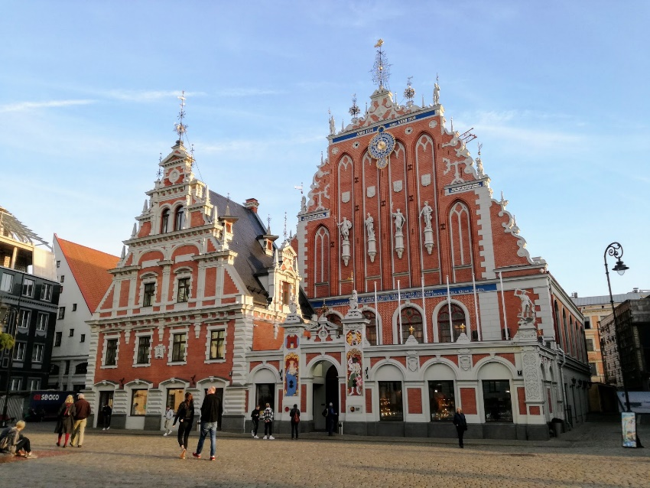
Can I really use it?
What are the conditions?
Can I make changes?
?
How to contribute the author?
Won‘t the author change his mind?

Slide 12
Public Copyright License
Non-exclusive
Free of charges
Valid for whole period when the work is protected
Undefined group of people
Doesn‘t mean waiver of copyright!
Examples: GNU, Common Public License (CPL), Creative Commons

Slide 13
Creative Commons
Public license allowing author to decide easily about public access to his work
Principle: author is offering a license agreement to the public = he offers some rights to his work
User doesn’t need to ask the author for allowance to use the work, he just uses the work in correspondence with the author’s conditions
creativecommons.org/licenses
Notes:
Podívat se na Wikipedii

Slide 14
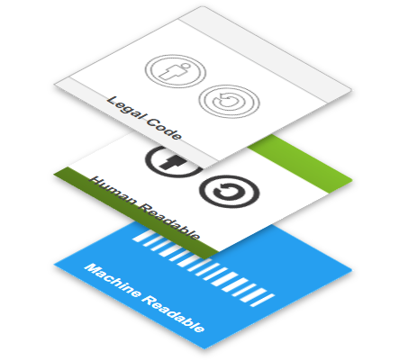
Three “layers” of the licenses
creativecommons.org/licenses

Slide 15
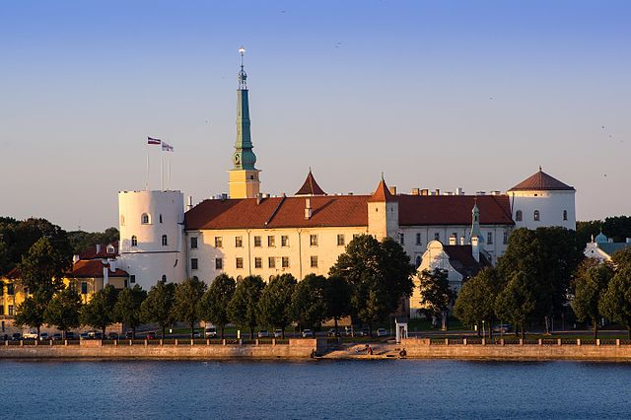
Creative Commons
The conditions of use are marked by simple symbols
should be part of the work
or close to the work
Always must be stated:
Identification of the author
Name of the original work
Source of the work
The license (or link to it)
By Bjørn Erik Pedersen – Riga Castle, CC BY-SA 4.0, https://commons.wikimedia.org/ w/index.php?curid=53904567

Slide 16
Creative Commons – Symbols
Any use of the work = CC BY
Derivatives allowed – only if shared alike (under a similar or same license) = CC BY-SA
Derivatives not allowed = CC BY-ND
Only for non-commercial use = NC
– can be added to any of the previous options
Notes:
Try to show an image on Wikipedia.
E.g. https://en.wikipedia.org/wiki/Tiger#/media/File:Panthera_tigris_tigris_Tidoba_20150306.jpg
The creative commons information is bellow.
You might try to search a different one. Most of Wikipedia images are licensed with Creative Commons.

Slide 17
Creative Commons Sources
…and many others
search
Notes:
Optional part
- provide explanatory notes for teachers if needed

Slide 18
And what if I want to share my own work?

Slide 19
Creative Commons: Author
Are you the owner of the work?
Do you know that the Creative Commons license may not be revoked?
https://creativecommons.org/choose
Notes:
Show the process of generating the creative commons information under the given link.
Copy it and paste it to the next slide.

Slide 20
About this presentation
Notes:
Example slide for pasting the creative commons code generated in the previous step.

Slide 21
References & acknowledgement
https://creativecommons.org/
https://wiki.creativecommons.org/wiki/Best_practices_for_attribution
https://en.wikipedia.org/wiki/Creative_Commons
https://en.wikipedia.org/wiki/Software_license
Presentation based at templates:
https://www.free-powerpoint-templates-design.com/colored-pencils-education-concept-powerpoint-template/
ENAI official template

Slide 22
About this document
Title of the work: Copyright in teacher‘s work
Attribute work to name: Dita Dlabolová (dita.dlabolova@mendelu.cz)
Licensed under: Creative Commons Attribution-ShareAlike 4.0 International License
Attribute using following text:
Copyright in teacher‘s work by Dita Dlabolová (dita.dlabolova@mendelu.cz) is licensed under a Creative Commons Attribution-ShareAlike 4.0 International License.

