Slide 1
How to deal with Contract cheating - workshop
Ing. Veronika Králíková
This workshop is based on INSTITUTIONAL TOOLKIT TO COMBAT CONTRACT CHEATING designed by ICAI in 2016 and previous workshops created in cooperation with Teddy Fishman and Dita Dlabolová

Slide 2
Outline of the workshop
Introducing the issue
Research results
How to deal with contract cheating
Prevention and detection

Slide 3
Introducing the issue

Slide 4
What types of cheating do you know?
Using unauthorized aids
Using a crib sheet on an exam
Copying
File sharing
Fabricating a report or data
Accessing external assistance from beyond the exam room by means of a cell phone
Having another student sign one’s name on an attendance sheet
Plagiarism
Contract cheating
WESTACOTT, E. (2008)
Discussion

Slide 5
Plagiarism is presenting the work of others as if it were his/her own without proper acknowledgment.
Tauginienė, L, Gaižauskaitė, I, Glendinning, I, Kravjar, J, Ojsteršek, M, Ribeiro, L, Odiņeca, T, Marino, F, Cosentino, M, Sivasubramaniam, S. Glossary for Academic Integrity. ENAI Report 3G [online].

Slide 6
Contract cheating is a form of misconduct when a person uses a third party to assist them to produce work, whether or not payment or favour is involved.
Tauginienė, L, Gaižauskaitė, I, Glendinning, I, Kravjar, J, Ojsteršek, M, Ribeiro, L, Odiņeca, T, Marino, F, Cosentino, M, Sivasubramaniam, S. Glossary for Academic Integrity. ENAI Report 3G [online].

Slide 7
Students who contract cheat might:
purchase an assignment from an online site or other online platforms
obtain assistance from someone else that goes beyond editing to writing of the assignment or solving of the problem
pay someone to write a assignment for them
impersonate other student for the purpose of exams or, in some cases, an entire class
share answers to an assignment

Slide 8
Problems of contract cheating
It is cheap
It is anonymous
7 EUR per one page
You don’t know the processor of the paper
It is accessible
It is fraud, but it is not illegal
Google, Facebook, other web pages
Process could be really fast
Just New Zealand and some US states
You can get the essay in less than 24 hours
It is hard to reveal
Companies pretend that they are doing a good thing
Essays tend to be original
It is even harder to prove it!
Providing just materials

Slide 9
…and it has a big impact
the credentials or degrees given by educational institutions are untrustworthy
it causes reputational damage to educational institutions
it allows students to purchase their way to a degree
devalues the education of other students who played by the rules
creates and contributes to a culture of fraud

Slide 10
Forms of contract cheating
(data from the Czech Republic)
60%
40%
Written by friend/classmate
Written by companies

Slide 11
Quality of the papers (from the CZE)
Two companies were asked to write the same essay.
The cost of the twelve-page essay was the same 2500 CZK (113 EUR)
Both companies had three weeks to work out
 | nepisto.cz | seminarkybezprace.cz
Date of submission | 5 days before deadline | Deadline date (late afternoon)
Quality | Very bad | Average
Mistakes | Incorrect number of pages, lack of expertise, invented literary sources,... | Grammar mistakes

Slide 12
HOW MANY STUDENTS ADMITTED TO CONTRACT CHEATING?

Slide 13
The Global Essay Mills Survey
Released 2017-18, for 13 weeks
3 Continents
Explored student experience and study behaviours at university, their reasons for studying, any outsourcing behaviours of their assignments, or knowledge of others.
Aasked students when they think it is OK to cheat, what the outcomes should be for cheating, and if they think essay mills should be illegal.

Slide 14
More than 10 000 responses
Answers together
22 languages
67%
Fully completed

Slide 15
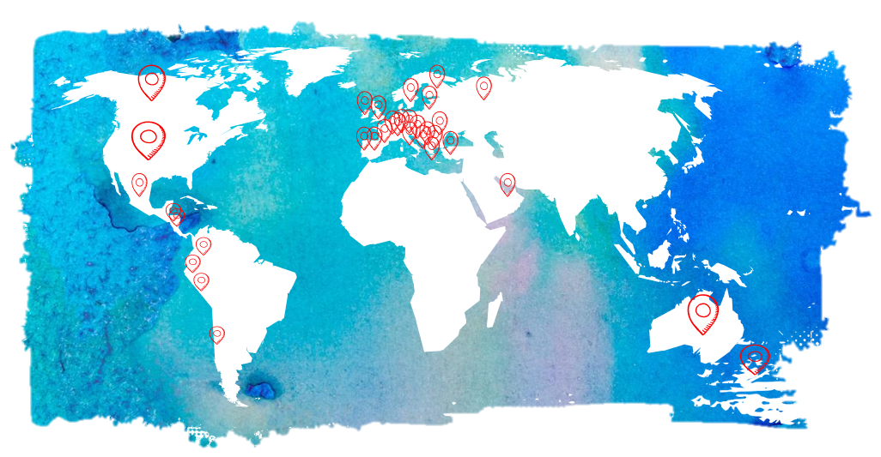
Countries

Slide 16
Results

Slide 17
Reasons why they cheated
Lack of time
Too many assignments due at the same time
Didn‘t uderstand the topic
Didn‘t see the purpous of the assignment
Laziness

Slide 18
How to deal with contract cheating?
Detection and prevetion

Slide 19
Who can help?
STUDENTS
They can help by getting involved in the education effort, being responsible for their own work, seeking out help from legitimate sources available on their own campuses.

Slide 20
Who can help?
PARENTS
They must instill in their students the real purpose and value of education and when talking to their students, ask them the right questions that focus on the value and coach the students in the right direction. NO PUSHING or PUNISHING.

Slide 21
Who can help?
FACULTY, TEACHERS AND INSTITUTIONAL STAFF
They can help by discussing academic integrity with their students, creating meaningful assessments, providing students with academic coaching, mentoring and tutoring, as well as opportunities to develop their writing, study, and time management skills.

Slide 22
Who can help?
INSTITUTIONAL LEADERSHIP OR MANAGEMENT
They must make integrity and ethics a core aspect of the strategic plan and also strongly support quality teaching and learning.

Slide 23
Who can help?
POLITICIANS/LEGISLATORS
They can make contract cheating illegal so that providers cannot operate in their district. Only New Zealand and 17 U.S. states have prohibitions against contract cheating.

Slide 24
How to deal with contract cheating?
If you are student!

Slide 25
Don’t cheat, be honest and support integrity
Basically don’t cheat
Be honest
Remember, that you came to the university to get KNOWLEDGE not only the degree
Share this attitude with your classmates and other students
In case you know that someone behave dishonestly, you should aware (convince) that person that it is not the right way
Report unethical behavior to relevant teachers/ institutions/ officers

Slide 26
How to deal with contract cheating?
If you are teacher!

Slide 27
Designing assessments - Prevention
Require multiple drafts
Use in-class writting
More personalized and authentic assingment
Limit non-substantive requirements
Allow late submissions
Use assigned seating
Check ID

Slide 28
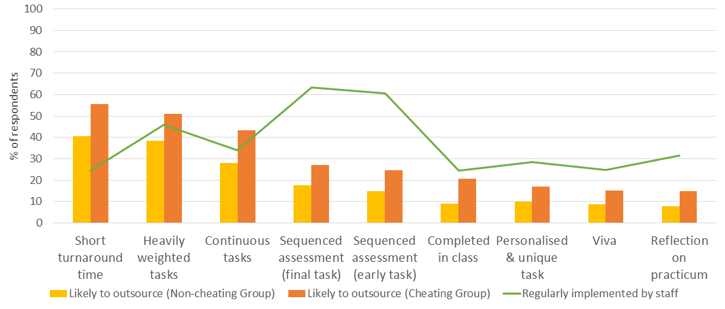
Types of testing and its likelihood for outsourcing
Bretag, 2018; Contract cheating and assessment design project

Slide 29
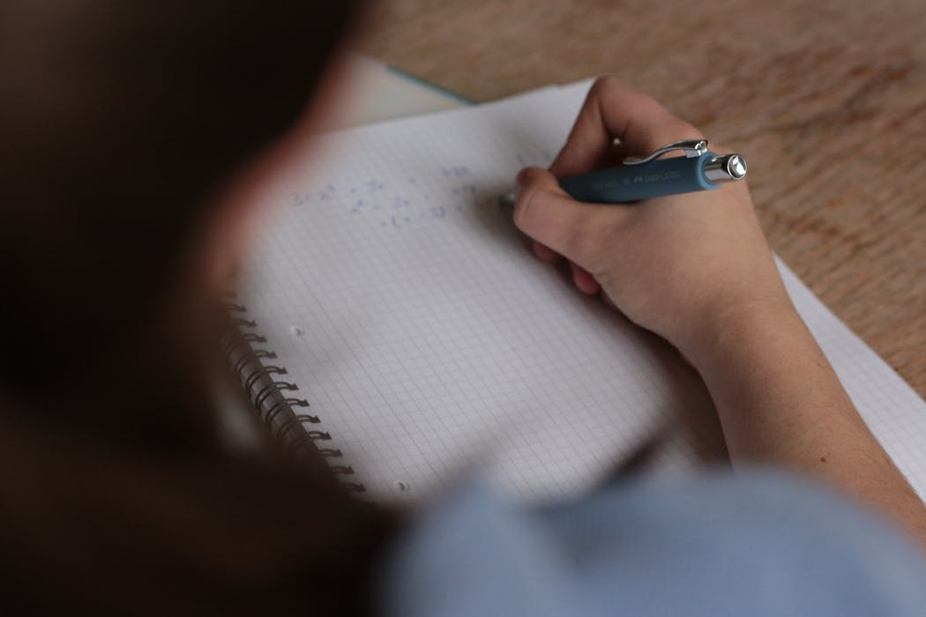
Detect when contract cheating has occured
Check properties of paper
Look for papers that are “too good to be true”
Ask student about the words and ideas in their paper as well as their process of writting
Use text matching software
Check the percentage
Get a second oppinion
Monitor testing environments
Use assigned seating
Check ID

Slide 30
What could be suspicious?
High match in text matching software
Too low match in text matching software
Very low sources
Very strange or unusual sources
Discussions and resources that do not relate to the topic
Resources that do not exist
Links to fraudulent sites
Stylistic changes within one or more works of the same author (language, grammar, vocabulary, formatting, fonts, etc.)
NOTE: Also, custom work can contain grammatical errors

Slide 31
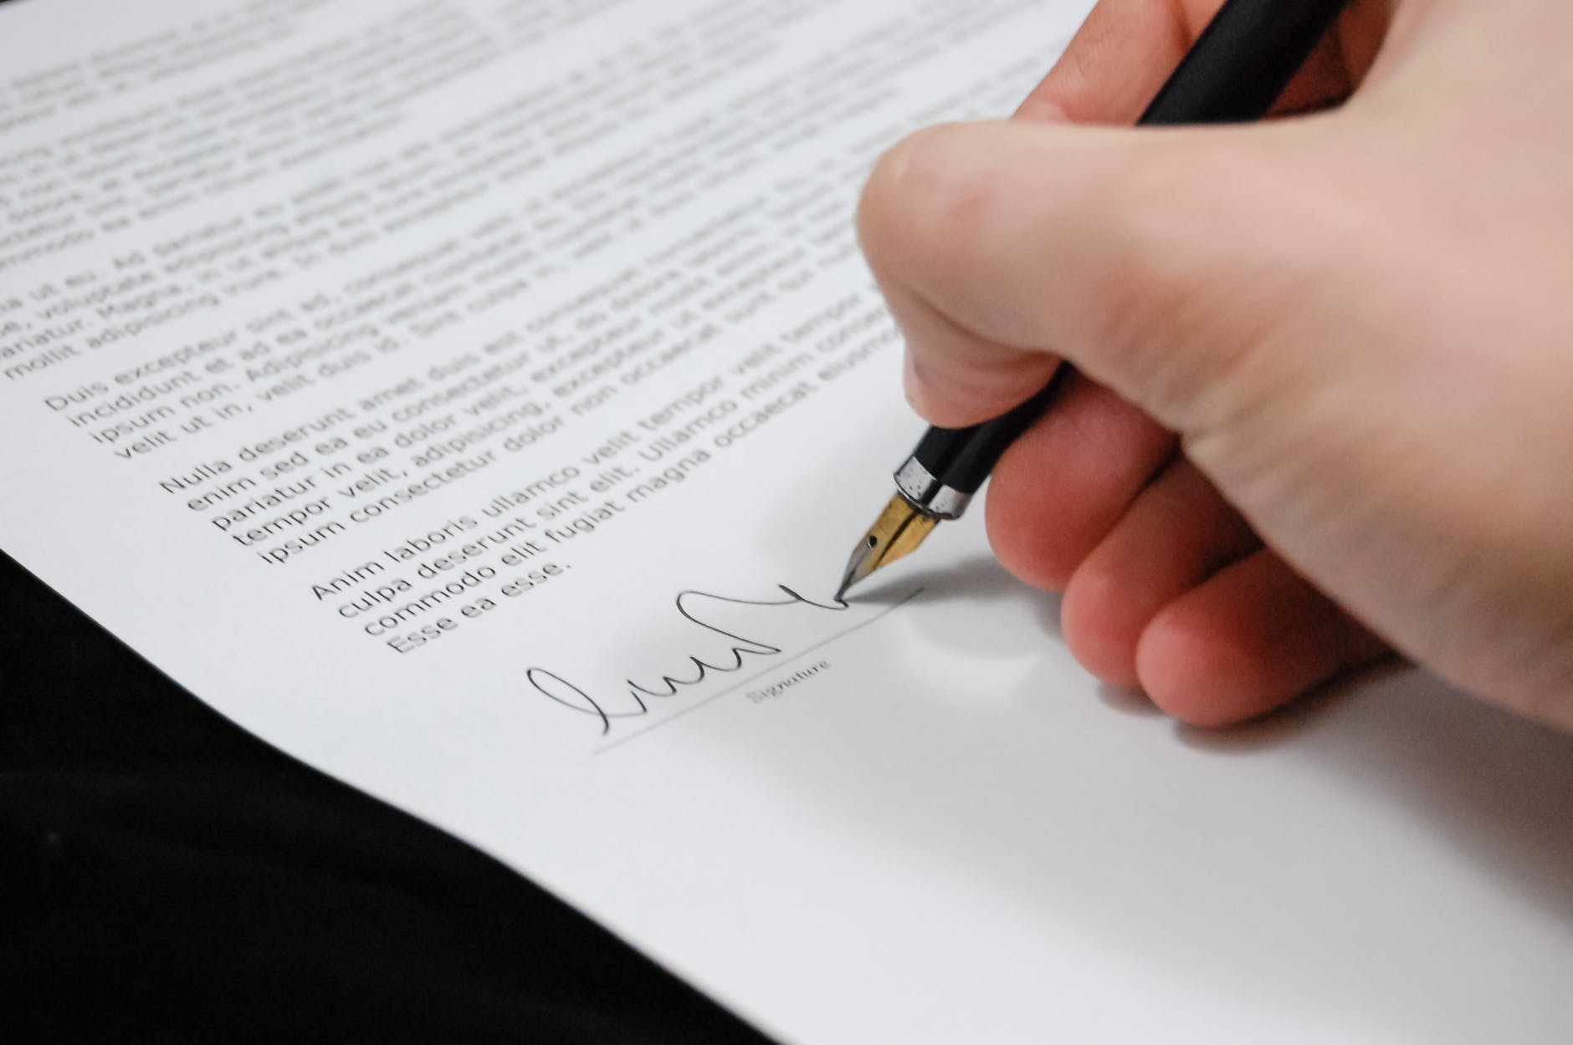
Make sure that contract cheating is prohibited
Ensure that the academic integrity policy is up-to-date
PUNISH every case of broken policy!
Work with local legislators and make it illegal!

Slide 32
Thank you!
Ing. Veronika Králíková (veronika.kralikova@mendelu.cz)

Slide 33
Bretag, 2018; Contract cheating and assessment design project: www.cheatingandassessment.edu.au.
Fishman, Teddi, 2017. How to deal with contract cheating [prezentace].
GEMS - Global Essay Mills Survey (data), 2018
Králíková, V. Analýza trhu s podvodnými seminárními a závěrečnými pracemi v ČR. Diplomová práce. Brno: Mendelova univerzita v Brně, 2017
Tauginienė, L, Gaižauskaitė, I, Glendinning, I, Kravjar, J, Ojsteršek, M, Ribeiro, L, Odiņeca, T, Marino, F, Cosentino, M, Sivasubramaniam, S. Glossary for Academic Integrity. ENAI Report 3G [online].
WESTACOTT, E. (2008). Academic dishonesty and the culture of assessment. Journal of the National Collegiate Honors Council--Online Archive, 65.
Pictures from pexels.com - Free for personal and commercial use

Slide 34
License Information
Title of the work: Contract cheating- workshop
Attribute work to name: Veronika Králíková (veronika.kralikova@mendelu.cz)
Licensed under: Creative Commons Attribution-ShareAlike 4.0 International License
Attribute using following text:
Contract cheating – workshop by Veronika Králíková (veronika.kralikova@mendelu.cz)
is licensed under a Creative Commons Attribution-ShareAlike 4.0 International License.

