Slide 1
One Hasty Decision
Notes:
Please give a name to your story ☺

Slide 2
Basic information
Target audience: Graduate students, junior faculty, junior researchers
Summary: The harshest sanctions which could be imposed when plagiarism has officially been detected
Objective: To help students consider the consequences of academic dishonesty in professional work life
Length: 30 minutes

Slide 3
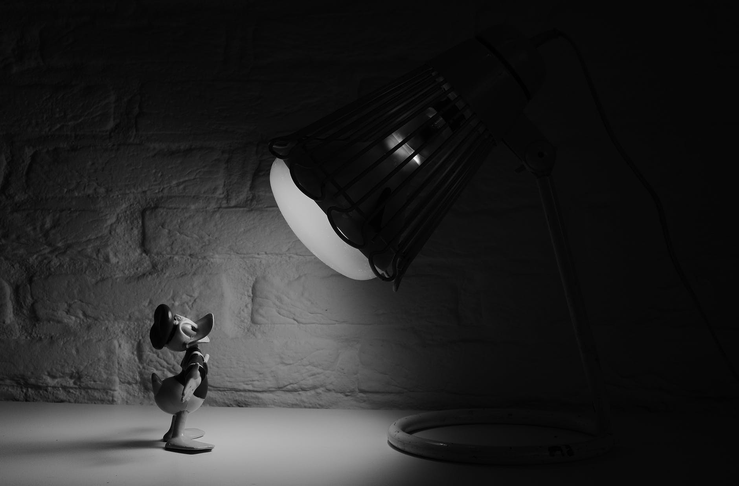
The story
Alex was employed as a full-time professor at Rabbit Habit University, one of the most high ranking universities in Neverland.
As a promising faculty member, he published numerous articles in different academic journals.
His intellectual background was being appreciated by his own institution and students.
Source: https://www.pexels.com/photo/black-and-white-cartoon-donald-duck-spotlight-3706/ (CC0 license)

Slide 4
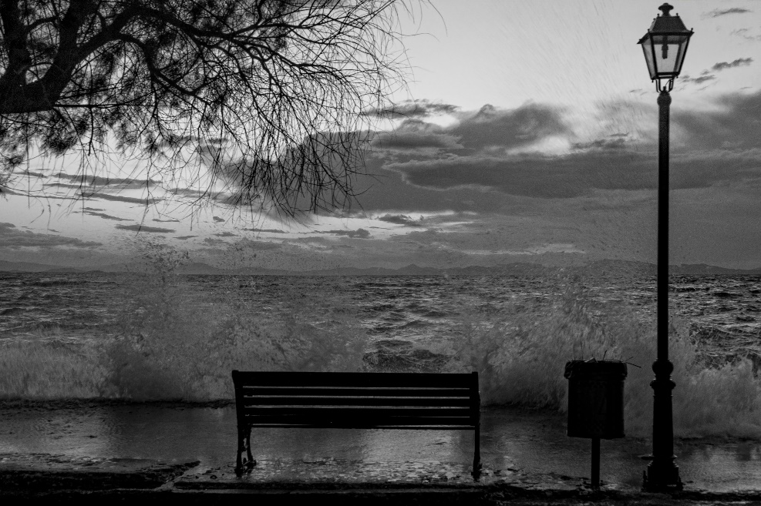
However, one hasty decision was enough to ruin all his academic career.
Source: https://www.pexels.com (CC0 license)

Slide 5

Prof. Dr. Alex Greenwich was publishing articles mostly in the field of international relations.
Prof. Greenwich aimed to edit a collection entitled ‘X Geopolitics and Economy in Neverland’ so he contacted some notable academics working in the field.
Source: https://www.pexels.com (CC0 license)

Slide 6
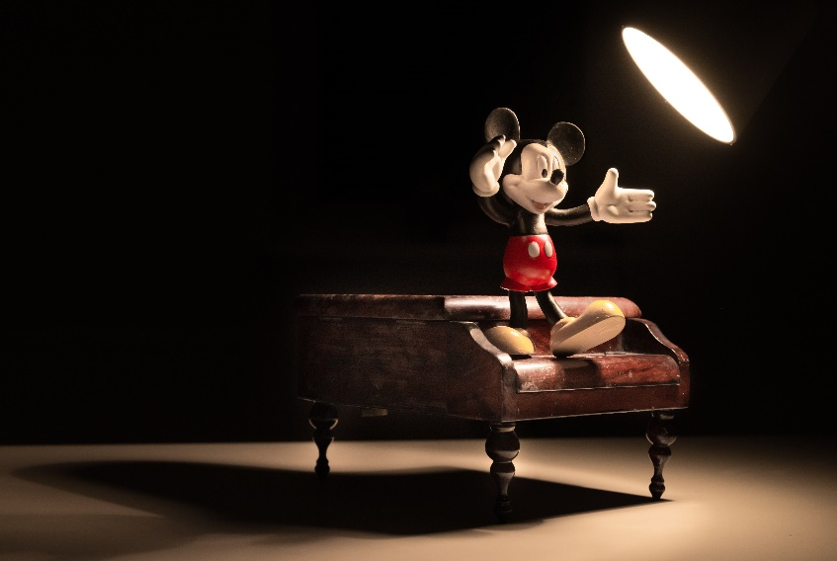
Related to this, Prof. Greenwich contacted Dr. Jason Blue, one of the most notable academics in Neverland working on X Region Politics.
In his email, Prof. Greenwich said that he would publish Dr. Blue’s article in his edited collection as a chapter.
Like all the other academics could do, Dr. Blue sent his article to Prof. Greenwich with great pleasure.
Source: https://www.pexels.com/photo/animation-cartoon-cartoon-character-disney-42415/ (CC0 license)

Slide 7
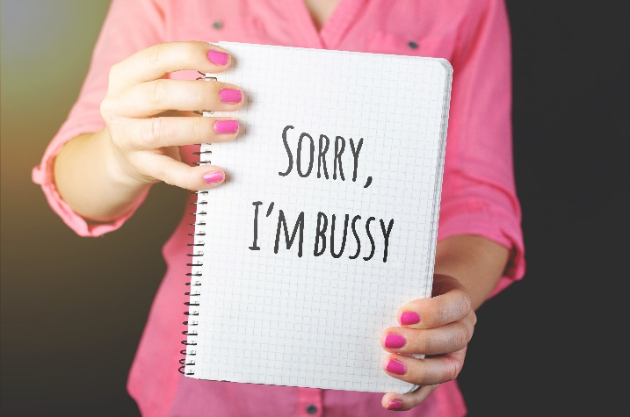
However, whenever Dr. Blue asked questions regarding the publishing process of the book, Prof. Greenwich was giving reluctant responses, namely, excuses.
For instance, in one of his emails, Prof. Greenwich said to Dr. Blue that he was on vacation and later he said that he was trying to reach some more scholars to release a more comprehensive book.
Source: https://www.pexels.com (CC0 license)

Slide 8

What is worse, after a period of time, Prof. Greenwich stopped contacting Dr. Blue.
In other words, Prof. Greenwich did not respond to the emails of Dr. Blue.
This made Dr. Blue to take an action: He decided to publish the study himself, not as a chapter but as a book.
So, he tried to extend the literature in his study by specifically searching for newly published studies related to this topic.
Source: https://www.pexels.com (CC0 license)

Slide 9
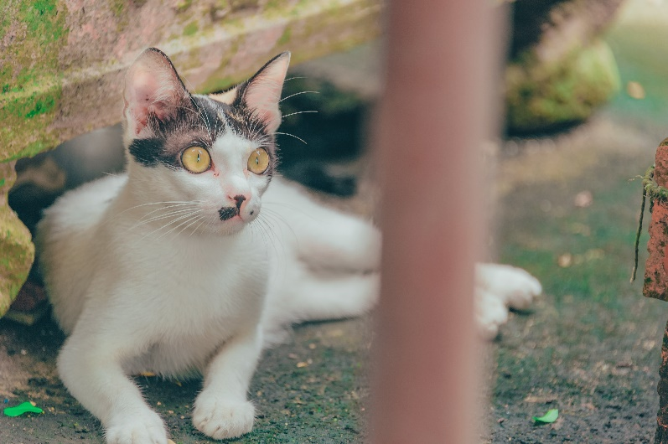
While Dr. Blue was reviewing the literature, he came across something shocking.
He checked it many times in order to be sure, but unfortunately, that shocking thing was in front of him, on his laptop screen.
Source: https://www.pexels.com (CC0 license)

Slide 10
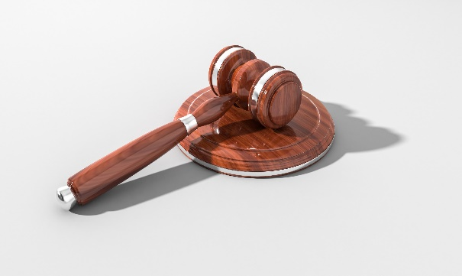
Dr. Blue noticed that his article was already presented and published by Prof. Greenwich in one of the prestigious conferences called ‘International Conference on X and Y Economies’.
As soon as Dr. Blue noticed that Prof. Greenwich had the article published in the conference book on pages 110-125, Dr. Blue sued him for pecuniary and non-pecuniary damages.
In addition, he wrote a petition to Neverland Council of Higher Education and Prof. Greenwich’s workplace, Rabbit Habit University regarding that plagiarism issue.
Source: https://www.pexels.com (CC0 license)

Slide 11

During the trial, Prof. Greenwich defended himself by stating that “he used Dr. Blue’s sentences inadvertently and he had no time to paraphrase properly because the conference deadline was tight”.
His final big excuse was that “one hasty decision made me act like that”.
Source: https://www.pexels.com (CC0 license)

Slide 12
Student Discussion
What do you think happened after?
What do you think about Dr. Blue’s steps?
What could have been done to prevent the problem?
What would you do if you were Dr. Blue?

Slide 13
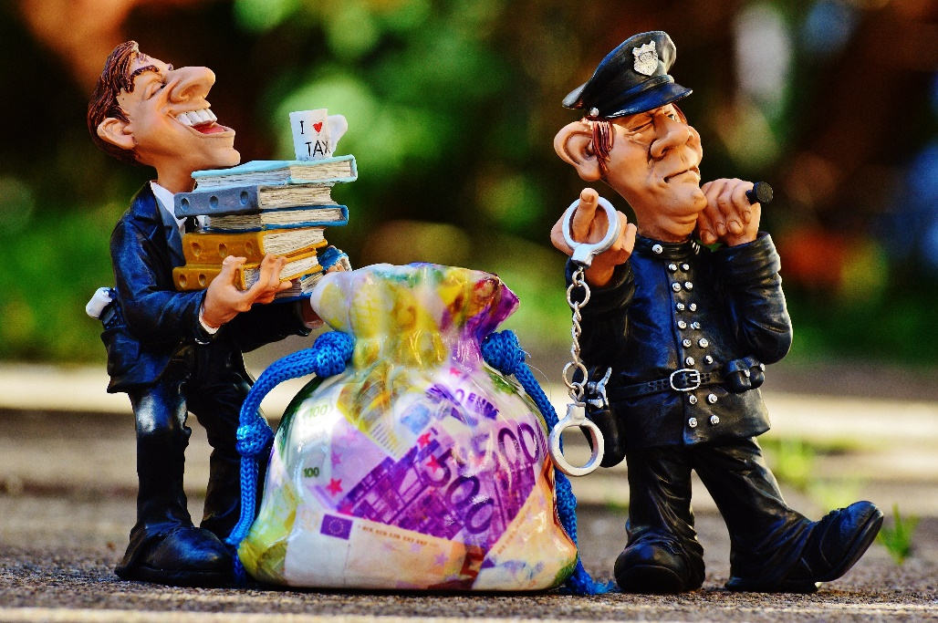
The conclusion
Dr. Blue said he felt the justice had been served!
Prof. Greenwich lost his position at Rabbit Habit University and he was sentenced to pay 10,100 Neverland denarius (≈€2,000) for damages.
Academic dishonesty ruined his reputation and costed him the academic career.
Source: https://www.pexels.com (CC0 license)
Notes:
Obligatory part

Slide 14
Acknowledgement – pictures source
All photos used are just illustrative, they are downloaded from an online photo-bank and the characters depicted have no connection with the presented story.
Author: Pexels
Lisenced under https://www.pexels.com/photo-license/
Source: https://www.pexels.com

Slide 15
Responsible authors
Salim Razı (salimrazi@gmail.com, salimrazi@comu.edu.tr)
Mustafa Çoban (muscoban09@gmail.com, mustafa.coban@btu.edu.tr)
2018

Slide 16

License Information
Title of the work: “One Hasty Decision”
Attribute work to name: ENAI (www.academicintegrity.eu)
Licensed under: creativecommons.org/licenses/by/4.0
Attribute using following text:
“One Hasty Decision” by Salim Razı and Mustafa Çoban is licensed under a Creative Commons Attribution 4.0 International License.

