Slide 1
Collaborate or Else! An Institutionalised Integrity Issue
Real life example O2-B-13-en

Slide 2
About this document
This document is a real life example illustrating importance of the values of academic integrity in professional life.
It was created as a part of Toolkit for cross-sector cooperation in terms of academic integrity within Erasmus+ project.
It is a ready-to-use case study accompanied with didactic notes and discussion questions and/or other tasks for the audience.
Find more case studies in ENAI database of educational materials.

Slide 3
Basic information
Target audience: PhD students (close to graduation), postdocs, researchers, technicians and academics.
Summary: the workshop highlights integrity issues amongst the research community.
Objective: to raise awareness of the issues related to research integrity.
Length: an hour workshop session.

Slide 4
Ethan, an enthusiastic young academic
Ethan, an enthusiastic young researcher with several years of post-doctoral experience has been appointed as a Lecturer at a respectable university.
During his induction week, he was introduced to the research coordinator of his faculty – Prof. Gillett.

Slide 5
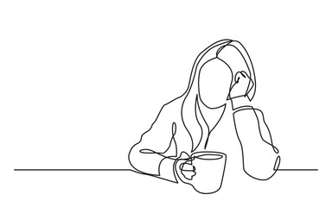
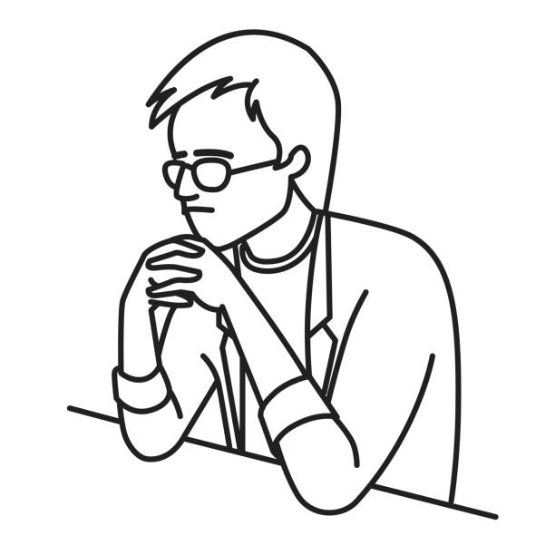
The future is bright!
Prof. Gillett was really friendly and she told Ethan about internal research funding for new academics.
Ethan was really excited and asked for more details.
Prof. Gillett told him to lodge a
research proposal ASAP!

Slide 6
The “I am God” attitude!
When Ethan was about to leave, Prof. Gillett asked:
“So, who is going to be your internal collaborator?”
Ethan: “Well, I have several years of research experience; also I already have a world renowned external collaborator lined up for this study, so I can manage without an internal collaborator.”
Prof. Gillett: “Well, it is up to you, young man,
but the offer is open.”

Slide 7
A colleague’s friendly advice
Puzzled by Prof. Gillett’s last comment, Ethan asked around about the procedures of internal funding application. It was then Mario, his office mate, who said:
“That woman is evil, she has her own selection committee; unless you include one of them as collaborators, your application will not be successful at all.”
But Ethan was confident about the novelty of his project proposal and said: “I trust my research idea” for which Mario said: “Good luck, but don’t say I haven’t warned you!”

Slide 8
The bad and unacceptable news!
Contrary to Ethan’s expectations, his research funding applications was rejected.
The reasons given:
Entirely new project
Lack of (Ethan’s) experience
No internal “mentors”
Yet, Ethan was asked to “consult” the research coordinator (Prof. Gillett) to improve the application and resubmit.

Slide 9
Appeal to the “Kangaroo court!”
Ethan appealed against the rejection with additional information.
He also submitted evidence against Prof. Gillett for research misconduct.
To his appal, the internal panel that handled his appeal was comprised of professors who are all internal collaborators of Prof. Gillett.
His appeal was rejected on the basis of lack of appropriate evidence.
Notes:
Kangaroo court = „a mock court in which the principles of law and justice are disregarded or perverted“ (Merriam-Webster Dictionary, https://www.merriam-webster.com/dictionary/kangaroo%20court)

Slide 10
The aftermath – Ethan’s future!
Subsequent applications from Ethan were all rejected.
Although he was successful in obtaining an external funding, the university failed to support (or match-fund) this, therefore the funding was withdrawn by the external body.
Ethan is now applying to other universities, for which no one is willing to write a reference for him.

Slide 11
Questions for Discussion
Find the integrity issues mentioned in this story.
Have you noticed similar incidences within or outside your organisation?
What else could Ethan do?
Discuss how these malpractices can be deterred at institutional level.
Notes:
Deter = discourage (someone) from doing something, typically by instilling doubt or fear of the consequences (definition by Google Translate).

Slide 12
Message of the story
This may not be an isolated case. In fact, this type of malpractice is widespread in academia. This workshop aims to highlight these “institutionalised malpractices” and offer help to PhD students, researchers and newly appointed lecturers.

Slide 13
Didactic/instructor’s notes
The story actually highlights practices common in some universities.
Please highlight the importance of confronting the baseless decisions internally as well as externally.
External organisations such as United Kingdom Research and Innovation (www.ukri.org) and German Research Ombudsman (www.enrio.eu) can help in similar cases.
We (ENAI - www.academicintegrity.eu), European Network of Research Integrity (www.enrio.eu) or International Centre for Academic Integrity (www.academicintegrity.org) can also advise on similar issues.
Also these cases should be widely publicised involving media.
Most importantly, the participants should be reassured that these are unacceptable practices and the more they are publicised, the better the chances of curtailing these issues.

Slide 14
Didactic/instructor’s notes
If needed, remind the audience, that:
Prof. Gillet is corrupted.
There is an obvious institution-wide corruption. The institution doesn‘t even have an objective board.
There is such a work terror/situation that it doesn‘t allow people to write a recommendation letter for their colleagues.

Slide 15
Anchor to the real case
This case study is based on real life experiences of two academics in two different institutions within UK and USA.
For the purpose of “story-telling” their experiences are merged.
Names are changed to ensure anonymity.

Slide 16
Acknowledgement & references
All line drawings were obtained from loyalty-free website https://openclipart.org/

Slide 17
Author & contact information
Dr S D Sivasubramaniam – s.sivasubramaniam@derby.ac.uk

Slide 18
License Information
Title of the work: Collaborate or Else!: An Institutionalised Integrity Issue
Attribute work to name: Dr S D Sivasubramaniam
Licensed under: creativecommons.org/licenses/by/4.0
Attribute using following text:
Collaborate or Else!: An Institutionalised Integrity Issue
by Dr S D Sivasubramaniam
is licensed under a Creative Commons Attribution 4.0 International License.

