Slide 1
Never cheat for the sake of perfectionism
Real-life example o2-b-14-en
Notes:
Please give a name to your story ☺

Slide 2
About this document
This document is a real-life example illustrating importance of the values of academic integrity in professional life.
It was created as a part of Toolkit for cross-sector cooperation in terms of academic integrity within Erasmus+ project.
It is a ready-to-use case study accompanied with didactic notes and discussion questions and/or other tasks for the audience.
Find more case studies in ENAI database of educational materials.

Slide 3
Basic information
Target audience: Graduate Students
Summary: The results of contract cheating
Objective: To help students consider the consequences of contract cheating in graduate studies.
Length: 30 minutes

Slide 4
Learning Outcome
The learners will be able to understand the legal results and sanctions stemming from contract cheating.
The learners will be able to notice the importance of getting professional assistance when they have faced with a problem such as pyschological barriers and writer’s block.

Slide 5
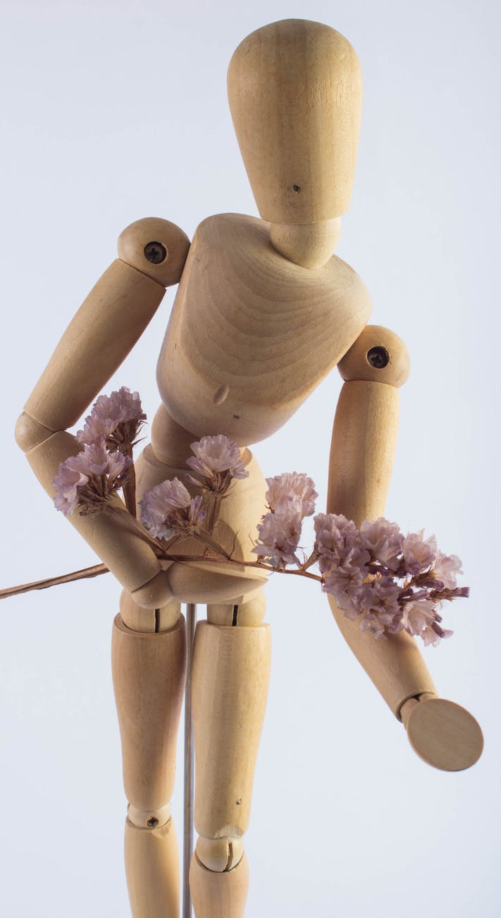
The story
Jane Forest was a graduate student at Robin Hood University. She was so highly ambitious for her academic career that she ranked among the best graduate students in the department. Her success was being appreciated by the faculty members.
However, she could not show similar progress while writing the thesis because she was a perfectionist. In fact, she was not satisfied with anything that she wrote unless it was completely perfect.
Everything was going badly!
Source: https://www.pexels.com/photo/wood-flowers-flower-detail-84505/

Slide 6

The story
As the English proverb says:
A man is known by the company he keeps.
Source: https://www.pexels.com/photo/silhouette-of-man-1480690/

Slide 7

The story
One day she decided to talk about that problem to one of her friends.
The friend mentioned about a person who could write Jane’s thesis at a good price. He gave the contact details of that person. At first, Jane did not want to accept it because she had always believed in the importance of academic integrity.
Source: https://www.pexels.com/photo/timelapse-photography-of-brown-wooden-puppet-running-on-a-black-screen-220443/

Slide 8

The story
That person’s name was Dr. Jack Wolf, who was a faculty member in the Department of Psychology at Peacock University.
Source: https://www.pexels.com/photo/person-wearing-red-hoodie-1097456/

Slide 9

The story
The next day, Jane texted Dr. Wolf. In a few minutes, Dr. Wolf called her back and agreed to meet in a café near the campus.
Dr. Wolf said that he would deliver the completed thesis in 3 months only if Jane transferred five thousand Euros to Dr. Wolf’s father’s account by the latest tomorrow. It was clear that Dr. Wolf had done such things many times before.
Source: https://www.pexels.com/photo/500-euro-bill-164537/

Slide 10

The story
Four months had passed since Jane contacted Dr. Wolf. There was not any news from him. Jane started to be worried about the thesis. She tried to reach him many times but Dr. Wolf did not respond to any of her emails and calls.
Source: https://www.pexels.com/photo/white-apple-iphone-on-wooden-table-48605/

Slide 11

The story
When Dr. Wolf saw Jane in his office waiting for him, he was shocked.
Jane said that she would tell everything about Dr. Wolf in a WhatsApp group created by the faculty members and graduate students from Peacock and Robin Hood Universities.
Source: https://www.pexels.com/photo/city-weather-thunderstorm-electricity-67102/

Slide 12

The story
Jane disclosed everything about the complicity in the contract cheating.
All academia in the country heard the scandal. Finally, Dr. Wolf lost his position and reputation.
At the same time, Dr. Wolf was arrested for bribery and fraud. Jane was dismissed from the graduate program.
Source: https://www.pexels.com/photo/silhouette-of-a-man-in-window-143580/

Slide 13
Discussion
Do you think that Jane Forest also should have been judged in the court?
Do you think that thesis advisors should be trained in fighting against academic dishonesty on a regular basis? If so, how?

Slide 14
Discussion
What could have been done to prevent the contract cheating in academia?
What would you have done differently if you were Jane Forest?

Slide 15
Fact or fiction?
Do you think that the story is based on a real case?

Slide 16
Fact!
The whole example is based on a real story which happened in 2018.

Slide 17
Acknowledgement & References
All photos used are just illustrative, they are downloaded from an online photo-bank and the characters depicted have no connection with the presented story.
Author: Pexels
Licenced under https://www.pexels.com/photo-license/
Source: https://www.pexels.com
Notes:
Obligatory part

Slide 18
Author & contact information
Salim Razı (salimrazi@gmail.com, salimrazi@comu.edu.tr)
Mustafa Çoban (muscoban09@gmail.com, mustafa.coban@btu.edu.tr)
2019

Slide 19

License Information
Title of the work: Never plagiarize for the sake of perfectionism
Attribute work to name: Salim Razı and Mustafa Çoban
Licensed under: Creative Commons Attribution-ShareAlike 4.0 International License
Attribute using following text:
Never plagiarize for the sake of perfectionism by Salim Razı and Mustafa Çoban is licensed under a Creative Commons Attribution-ShareAlike 4.0 International License.

