Slide 1
Academic integrity and plagiarism on Slovenian academic institutions
Milan Ojsteršek
University of Maribor, Faculty of Electrical Engineering and Computer Science
milan.ojstersek@um.si;

Slide 2
The state of open access and academic integrity in Slovenia in 2012
More than 40 open access journals and more than 20 digital archives and repositories.
Publications have been duplicated across different repositories or digital archives.
Inadequate quality of metadata of research publications, research data, dissertations and theses.
Processes for submission of final study works (theses and dissertations), research publications, research data and other academic production have not been established.
No common search engine for theses, dissertations, research publications, research data and other academic production.
Lack of common recommender system and plagiarism detection system.
Lack of metadata, data, content, submission and preservation policies.
Lack of documents for supporting academic and research integrity.
Notes:
Prior to the implementation of this project, there were already some open access repositories and digital archives in Slovenia that contained the final study works and research publications. These contents were, in most cases, inserted by librarians and not by the authors. Most institutions did not define adequate processes and legal background that would enable authors to deposit their publications within the repositories. An exception was the Digital Library of the University of Maribor, where such a process had already been implemented, thus enabling students to submit their final study works to the digital library. As it was impossible to simultaneously search the contents from different repositories and digital archives and with an absence of processes and policies for the submission of content, the consortium of Slovenian universities has decided to sign up to a call from the Ministry of Education, Science and Sport and has received funding for the establishment of a national infrastructure of open access (from the Ministry and the European Regional Development Fund).
During the initial import of metadata from digital archives, repositories and our national cataloguing system COBISS.SI into the national open access infrastructure, we discovered certain deficiencies in the metadata of the bibliographical records. Here are some of the more frequent:
Metadata containing spelling errors (e.g., wrong URL, misspelt title …).
Only a minimal range of metadata is provided (e.g., the title, keywords and authors), whereas other metadata are unavailable (e.g., abstract, title and keywords in other languages etc.). A lot of scientific papers don‘t contain metadata about journals or proceedings in which its have been published or these metadata have been uncompleted for citation in different citation styles.
Some fields contain semantically different data as foreseen by the content of the field (e.g., a patent number is stored in the subtitle field, as the COMARC format does not provide a field for inserting patent numbers).
Due to the long history of COBISS (it was started in 1981), some fields have remained alphanumeric, although they should be numeric. In some cases data is still entered as alphanumeric instead of only numeric.
Some of the metadata that are entered in the institutional repository are, on the other hand, not contained by COMARC. In our case, theese metadata describes patents (patent number, patent expiry date), projects (project number, funding scheme, project title, project acronym, type of access, embargo date), metadata about copyright (COMARC enables insertion of this field in string format, instead of attribute data about the licence), geographic coverage (e. g., COMARC does not support attribute data for geographical coordinates or usage of geographical vocabularies).

Slide 3
A network diagram of the Slovenian open access infrastructure
Open Science Slovenia (http://www.openscience.si)
      similar content detection,
      federated search,
      recommendation system.
RUL
DKUM
RUP
RUNG
DIRROS
REVIS
Other digital archives
ePrints.FRI
PeFprints
DRUGG
SSDA
dLib
Videolectures.NET
DKMORS
ZRC SAZU
Notes:
The infrastructure consists of Slovenian universities’ repositories (repository of University of Ljubljana, digital library of University of Maribor, repository of University of Primorska and repository of University of Nova Gorica), a repository for research organisations, repository for faculties which are not part of universities and a national portal that aggregates content from the repositories and other Slovenian archives (Digitalna knjižnica Slovenije (dLib.si), VideoLectures.NET, digital library of Ministry of Defence (DKMORS), Social Science data archive (SDA) and ScieVie repository). The national portal ‘openscience.si’ provides a common search engine, recommendations for similar publications, and similar text detection.

Slide 4

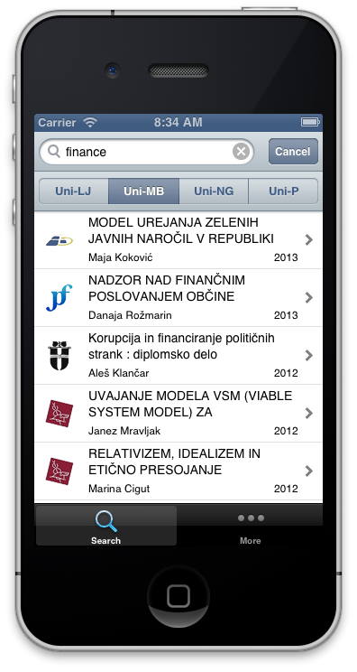



UL document management system
InstitutionalWeb servers
web service
JavaScript API
RSS
OpenAIRE,
DART-Europe,
BASE,
ROAR,
OpenDOAR
…
ARNES AAI or University authentication system
Institutional repository
OAI-PMH
The institutional repository linked to external systems and the national portal
XML or LDAP
web service
XML or
LDAP
web service
SRU/SRW
University academic information system
Open Science Slovenia
web service
web service
XML, web service, OAI-PMH
OAI-PMH
SRU/SRW
XML
JSON
OAI-PMH
EPrints repositories
Social Science Data Archives
dLib.si
Videolectures.NET
DKMORS
Other sources
Notes:
Figure shows how the institutional repository of a Slovenian university is linked to other systems. In order to establish the processes of submission and the cataloguing of publications, the institutional repository is linked to the authentication system of the university or ARNES AAI the Slovenian academic authentication system, the university academic information system, and the national bibliographic catalogue (COBISS.SI). At the University of Ljubljana the electronic versions of publications are additionally stored within their own document management system after they have been catalogued. Other institutions keep the electronic versions of publications in their institutional repository. The national portal is used as a secondary storage of publications and metadata. The institutional repository sends metadata and electronic versions of publications to the national portal immediately after their cataloguing within COBISS.SI. Every institutional repository also receives additional metadata about researchers and research organisations from Slovenian common research information system (SICRIS) via the national portal. A common recommendation system is installed at the national portal “Open Science Slovenia”. On clicking on the document in the institutional repository, the national portal sends a list of similar documents. The recommendation consists of publication titles from within the same institutional repository and of publication titles from other institutional repositories and digital archives (dLib.si, VideoLectures.NET, DKMORS. SSDA).
A JavaScript API is also available in the institutional repository. It is used for mobile and web applications to display information about publications. Once included within a website (e.g., the faculty website), it enables simple or advanced searches as well as browsing through publications within the institutional repository. An example of such inclusion can be seen on the website »Publications of the Faculty of Social Sciences« from the University of Ljubljana. Faculties and their staff can also use the publication metadata in RSS, JSON or RDF formats. RSS feeds are also generated for lists of the latest submitted or the most downloaded publications.
The institutional repositories have a back-end intended for use by the administrators, and a front-end intended for the general public and registered users. The back-end is used by student officers, librarians, and system administrators. The student office mainly carries out the review of final study works, whilst the librarians review the publications of both students and staff, and catalogue them in COBISS.SI as well as import the COBISS.SI metadata records into the institutional repository.
The back-end allows the librarian to import the metadata records of those publications from COBISS.SI and link electronic versions of the publication to it. In this way the metadata of those publications that have already been catalogued in COBISS.SI can be imported into the institutional repository. Such publications are mostly older and were published before the establishment of the institutional repository but electronic versions of them do exist and the universities have cleared the appropriate copyright for storing them in their repositories and the enabling of web access.
By logging onto the institutional repository, students and staff from the Universities of Maribor and Nova Gorica can submit their publications and final study works into the repository and review their content (metadata and similar documents, as found by the plagiarism detector). The submissions of final study works from students at the Universities of Ljubljana and Primorska take place as universities’ academic information systems. The submissions of research publications and data by researchers are done in institutional repositories. A bilingual (Slovenian and English) interface is available for the visitors of web and mobile applications (Android, iPhone and Windows Phone). The website is suitable for people with disabilities and enables browsing as well as simple and advanced search functions.
Those faculties and academies that had already established the repositories (Faculty of Computer Science, Faculty of Civil and Geodetic Engineering, and the Faculty of Education) are part of the University of Ljubljana; therefore all of the content from these repositories has been transferred into the Repository of the University of Ljubljana via the national portal. The latter obtains the new metadata records daily using OAI-PMH servers. These records are then enriched using internal metadata from the EPrints XML and metadata from COBISS.SI. The linking can be done only if the librarians have entered the URL into COBISS.SI or if the EPrints XML description contains the COBISS.SI identifier. In the case of overlapping data, the national portal takes metadata from COBISS.SI as they are more trustworthy. In many cases, the two sets of metadata complement each other. For example, if a record exists where the librarians did not provide an abstract in the alternative language in COBISS.SI or they did not provide a parent publication in EPrints, then the metadata are simply merged.
From the beginning of 2014, the European Commission has required that in Horizon 2020 open access is provided to all publications from co-funded projects. The European Commission co-financed the European open access infrastructure for research (projects OpenAIRE (2009-2012) and OpenAIREplus (2011-2014)). They have established a server, which collects the metadata of publications that were published as a result of co-funded EU projects. Due to this, the institutional repositories needed to store additional metadata of publications. Researchers have to input the funder’s acronym, the funding scheme, the project number, and optionally the project title and the project acronym. A common vocabulary that stores the funders’ and funding schemes has been established. It includes data from the European Commission and data about all funders and funding schemes, as currently used by all Slovenian funders. Each institutional repository has an OAI-PMH server, which returns an OpenAIRE compatible XML for publications. EC servers can therefore use these publications to evaluate the compliance of co-funded projects. The OAI-PMH server is also used by open access registries of repositories and search engines (OpenDOAR, ROAR, DART-Europe, BASE, etc.).
ARNES AAI - Slovenian Academic Authentication System. Retrieved February 18, 2014, from http://www.arnes.si/en/services/arnesaai.html.
FDV Publications. Retrieved February 18, 2014, from http://www.fdv.uni-lj.si/en/fdv-publications/home.
Web Accessibility Initiative. Retrieved February 18, 2014, from http://www.w3.org/WAI/.
Open Access Infrastructure for Research in Europe. Retrieved February 18, 2014, from https://www.openaire.eu/.

Slide 5
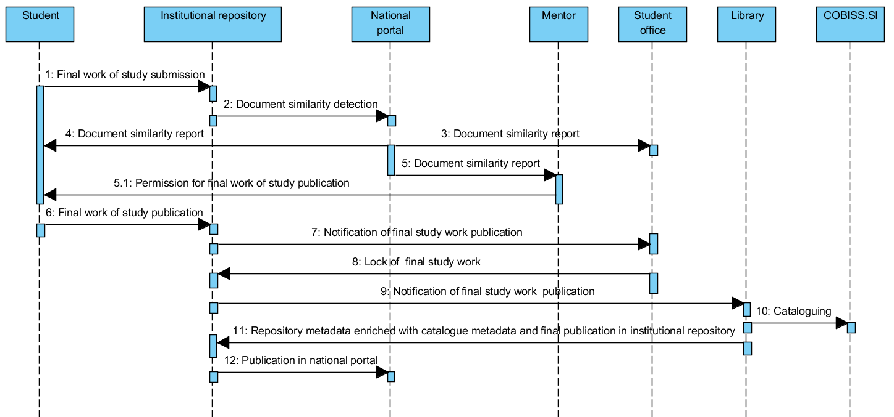
A sequence diagram of final study work submission and publication at the universities of Maribor and of Nova Gorica
Notes:
The process, which was established at universities, allows authors to submit their work into the institutional repository. After which, the submission is reviewed and catalogued into COBISS.SI by a librarian. Based on the experiences accumulated since 2008, it was found that a manual review of metadata is mandatory as in many cases the submissions are incomplete or contain spelling errors. In addition, only librarians can normalise those authors using the CONOR.SI authority file. After the publication metadata have been successfully catalogued within the COBISS.SI, they can be transferred to the institutional repository via SRU/SRW services.
The working group, which consisted of librarians, legal experts and IT professionals from all four Slovenian universities, suggested the submission processes of the final study works. Slovenia lacks a common university academic information system (UAIS), therefore each university provided its own variation of this process. Students at the universities of Maribor and of Nova Gorica submit their final study works into university repository, which is filled with some metadata from university academic information system. A sequence diagram of the final study work publications of the universities of Maribor and of Nova Gorica is presented in slide. The submissions at the universities of Ljubljana and Primorska take place at university academic information system, the sequence of operations is otherwise the same as described for the universities of Maribor and of Nova Gorica.

Slide 6
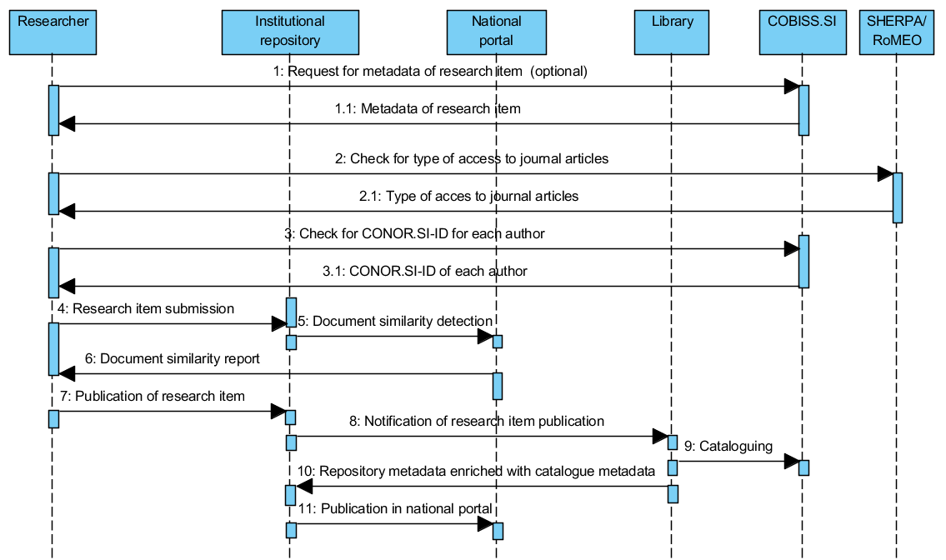
A sequence diagram of research item submission and publication
Notes:
All four institutions have established the same process for submission of research publications, which is presented the sequence diagram in the slide. Researchers can submit articles, monographic chapters, monographs, conference papers, e-lectures, publications about patents, research data, and other types of publications. The types of publications are adapted according to the COBISS.SI typology (http://home.izum.si/COBISS/bibliografije/Tipologija_eng.pdf), which is used by the Slovenian Research Agency for researchers’ bibliographies evaluation. Once researchers are logged into the institutional repository, they can submit new content as a whole, or they can use metadata from the catalogued record in COBISS.SI (optional request and reply on the beginning of the process). In the latter case, the institutional repository takes care of the metadata transfer from COBISS.SI using the SRU/SRW protocol. In this case, researchers only need to provide the electronic version of their publications. A link to the SHERPA/RoMEO portal is also enabled to the publication authors, so they can check what type of access they can use depending on the publisher's copyright transfer agreement. During the insertions of names and surnames, suggestions from the CONOR.SI authoritative file are provided. These suggestions include the year of birth, if available in CONOR.SI, and researcher identifier from SICRIS, which simplifies the determination of the correct author. This can greatly simplify the librarian’s work of cataloguing the publication in COBISS.SI. Authors can also determine the copyright holder and the type of access to the full-text publication. They can choose between immediate publication, closed access or delayed publication with embargo (these metadata are part of OpenAIRE compliance).

Slide 7
Documents that are base for supporting of academic integrity at Slovenian universities
Statute.
Code of Ethics.
The European Code of Conduct for Research Integrity.
Rules on protection of intellectual property.
Open access policy.
Rules on verifying and assessing student‘s knowledge.
Rules of preparation and defence of final study works.
Instructions for checking the similarity of the content in the final study work.
Plagiarism policy.
Guides for plagiarism prevention and awareness.

Slide 8
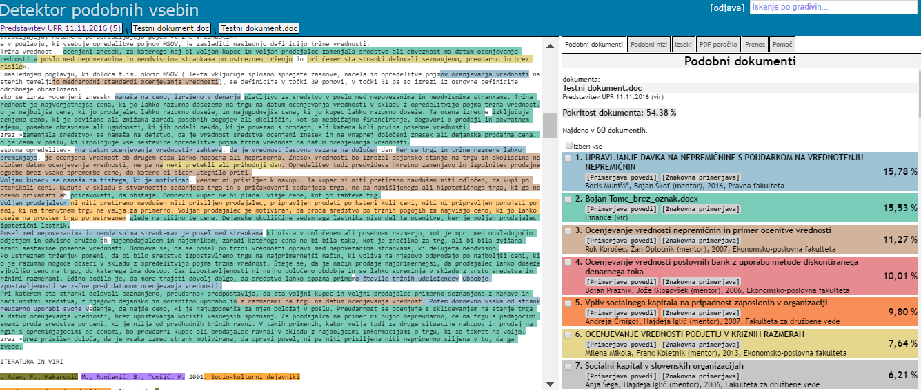
User interface of Slovenian plagiarism detection system
Notes:
Document similarity detection (or plagiarism detection) is done within the national portal. The results of plagiarism detection are available to students and staff. They can only see those documents where they had the roles of author, co-author or mentor. The detection is performed for each publication, submitted into the repositories. Both coarse-checking (step 1) and fine-checking (step 2) analyses are supported by the custom-built software of our laboratory. The software does not check the similarities between images.
Software for coarse-checking texts returns similar sentences that are longer than forty characters (example of a result is shown on figure - above). It enables coarse-checking due to its use of our tool for natural language processing, called TextProc. The language infrastructure used during the plagiarism detection process, consists of a morphological dictionary for the Slovenian language, which contains of approximately 8,000,000 word forms and 320,000 lemmas. Wikipedia labels from article titles from Slovenian, English and German Wikipedia are also used. They were extracted from Dbpedia. A domain-specific semantic dictionary was created using keywords from publications metadata within the Open Science Slovenia portal. Sentences, marked by the coarse-checking software as similar, are undoubtedly the same in both texts. They differ only if the authors used synonyms, used a different grammatical person or used filler words (e.g. »therefore«, »however«). The software detects similarity even if the word order is changed or if any of the words are misspelled. The Coarse-checking algorithm which has been subsequently updated, first converts the text into UTF-8 format, eliminates extra whitespaces and new line characters (CR, LF). Then it splits the content into sentences. Words from these sentences are then lemmatised. Common words (e.g. »and«, »or«, »that«, etc.) are filtered out and all the remaining words are sorted alphabetically. This step also carries out spelling corrections using a morphological dictionary and POS tagger. In order to correct spelling errors the “Symmetric Delete Spelling Correction Algorithm” is used. After the lemmatisation, the algorithm normalises those synonyms stored within the dictionary and can be transformed into single forms without changing the semantic meanings. A good example of this are the normalisations of the verbs »to present«, »to describe« and »to show«, which are synonyms in most cases. The algorithm then calculates hashes for these sentences. Finally, it compares the hashes of sentences from other documents within the corpus of documents, calculates the coverage of hashes for document pairs and provides a list of similar documents for every document within the corpus.
Those documents that are found to be more than 1 % similar to the reviewed document during the coarse-checking step become candidates for entering into the fine-checking step. If the number of these candidates is less than 50, the rest of the similar documents are retrieved using the BM25 ranking function- The fine-checking algorithm (figure below) finds the longest common sub sequences between two texts. Kärkkäinen's algorithm is used for finding common sub-sequences greater than 14 characters. Our algorithm (authors are Ferme and Ojsteršek) for sequence matching is used in cases where the pairs of documents have more than 60 % of coarse-checking coverage of hashes. This algorithm has a time complexity of nearly O(N) if the pairs of documents are very similar. No spelling corrections are carried out for those texts using ‘as-is’. If two documents are fine-checked (ffigure below), the software marks those phrases or parts of sentences that are the same within both documents. A reviewer's task is to determine whether a sentence or a paragraph has been copied. Some sentences can be semantically identical as a whole or in part if the author has paraphrased the copied content. Similarity constants (1% of coarse-checking coverage, 50 candidate documents for fine-checking, sentence length of 40 characters, subsequence length of more than 14 characters, etc.) are selected on the basis of experiences from examination plagiarism cases.

Slide 9
Our test corpus of 80011 documents (average similarity is 19,29%)
SCIENTIFIC AREA | number of publications | percent of publications | average similarity | difference from average similarity | standard deviation of % similarity
BIOMEDICAL SCIENCES | 1250 | 1,56 | 16,49 | 2,80 | 15,49
SOCIAL SCIENCES | 45442 | 56,79 | 20,46 | -1,17 | 16,26
HUMANITIES | 1153 | 1,44 | 15,90 | 3,39 | 16,05
NATURAL SCIENCES AND MATHEMATICS | 9908 | 12,38 | 14,36 | 4,93 | 14,35
TECHNOLOGICAL SCIENCES | 22258 | 27,82 | 19,43 | -0,14 | 15,11
SUM | 80011 | 100,00
Publications typology | number of publications | percent | average similarity | difference from average similarity | standard deviation of % similarity
Scientific paper | 3271 | 4,09 | 15,39 | 3,90 | 16,88
BSc Thesis | 53327 | 66,65 | 20,74 | -1,45 | 15,78
PhD thesis | 1577 | 1,97 | 8,56 | 10,73 | 9,95
MSc thesis | 9906 | 12,38 | 16,84 | 2,45 | 13,17
Other | 11930 | 14,91 | 17,34 | 1,95 | 17,20

Slide 10
Distribution of publications with regard to their percent of similarity
SCIENTIFIC AREA / percent of similarity | 0-10 | 10-20 | 20-30 | 30-40 | 40-50 | 50-60 | 60-70 | SUM
BIOMEDICAL SCIENCES | 514 | 321 | 194 | 99 | 61 | 50 | 11 | 1250
SOCIAL SCIENCES | 14626 | 10994 | 8155 | 5352 | 3378 | 1983 | 954 | 45442
HUMANITIES | 515 | 283 | 156 | 86 | 48 | 37 | 28 | 1153
NATURAL SCIENCES AND MATHEMATICS | 4705 | 2376 | 1451 | 712 | 352 | 231 | 81 | 9908
TECHNOLOGICAL SCIENCES | 7112 | 6185 | 4051 | 2420 | 1366 | 769 | 355 | 22258
SCIENTIFIC AREA / percent of publications with percent of similarity | 0-10 | 10-20 | 20-30 | 30-40 | 40-50 | 50-60 | 60-70
BIOMEDICAL SCIENCES | 41,12 | 25,68 | 15,52 | 7,92 | 4,88 | 4,00 | 0,88
SOCIAL SCIENCES | 32,19 | 24,19 | 17,95 | 11,78 | 7,43 | 4,36 | 2,10
HUMANITIES | 44,67 | 24,54 | 13,53 | 7,46 | 4,16 | 3,21 | 2,43
NATURAL SCIENCES AND MATHEMATICS | 47,49 | 23,98 | 14,64 | 7,19 | 3,55 | 2,33 | 0,82
TECHNOLOGICAL SCIENCES | 31,95 | 27,79 | 18,20 | 10,87 | 6,14 | 3,45 | 1,59

Slide 11
Distribution of publications with regard to their percent of similarity

Slide 12
Distribution of publications by issue year with regard to their percent of similarity
Publications with more than 20% and less than 70 % of similarity with other documents
SCIENTIFIC AREA / number of publications per year (N) |  | 2000-2005 | 2006-2010 |  | 2011 | 2012 | 2013 | 2014 | 2015 | 2016 | SUM
BIOMEDICAL SCIENCES |  | 8 | 127 |  | 70 | 54 | 39 | 21 | 26 | 12 | 357
SOCIAL SCIENCES |  | 2617 | 5219 |  | 2094 | 1767 | 1348 | 1368 | 1288 | 1802 | 17503
HUMANITIES |  | 39 | 117 |  | 41 | 36 | 27 | 27 | 5 | 9 | 301
NATURAL SCIENCES AND MATHEMATICS |  | 75 | 667 |  | 311 | 303 | 278 | 329 | 264 | 258 | 2485
TECHNOLOGICAL SCIENCES |  | 1787 | 2681 |  | 730 | 710 | 537 | 466 | 476 | 621 | 8008
Publications with less than 70 % of similarity with other documents
SCIENTIFIC AREA / number of publications per year (N all) | 2000-2005 |  | 2006-2010 | 2011 |  | 2012 | 2013 | 2014 | 2015 | 2016
BIOMEDICAL SCIENCES | 65 |  | 311 | 134 |  | 128 | 130 | 118 | 111 | 94
SOCIAL SCIENCES | 5100 |  | 10368 | 4211 |  | 3931 | 3399 | 3406 | 4038 | 5965
HUMANITIES | 160 |  | 308 | 108 |  | 114 | 103 | 85 | 61 | 77
NATURAL SCIENCES AND MATHEMATICS | 514 |  | 1702 | 798 |  | 831 | 873 | 936 | 1015 | 1282
TECHNOLOGICAL SCIENCES | 2691 |  | 5437 | 1759 |  | 1797 | 1671 | 1558 | 2084 | 3137
Distribution of publications by issue year with regard to their percent of similarity
SCIENTIFIC AREA / (N/N all) peer year | 2000-2005 | 2006-2010 | 2011 | 2012 | 2013 | 2014 | 2015 | 2016
BIOMEDICAL SCIENCES | 12,31 | 40,84 | 52,24 | 42,19 | 30,00 | 17,80 | 23,42 | 12,77
SOCIAL SCIENCES | 51,31 | 50,34 | 49,73 | 44,95 | 39,66 | 40,16 | 31,90 | 30,21
HUMANITIES | 24,38 | 37,99 | 37,96 | 31,58 | 26,21 | 31,76 | 8,20 | 11,69
NATURAL SCIENCES AND MATHEMATICS | 14,59 | 39,19 | 38,97 | 36,46 | 31,84 | 35,15 | 26,01 | 20,12
TECHNOLOGICAL SCIENCES | 66,41 | 49,31 | 41,50 | 39,51 | 32,14 | 29,91 | 22,84 | 19,80

Slide 13
Distribution of publications by issue year with regard to their percent of similarity

Slide 14
Where you can find more information
National portal of open science: http://www.openscience.si/Default.aspx
DKUM: https://dk.um.si/info/index.php/eng/
RUL: http://repozitorij.uni-lj.si/info/index.php/eng/
RUP: http://repozitorij.upr.si/info/index.php/eng/
RUNG: http://repozitorij.ung.si/info/index.php/eng
DIRROS: http://dirros.openscience.si/info/index.php/eng
REVIS: http://revis.openscience.si/info/index.php/eng
Our publication:
Milan Ojsteršek , Janez Brezovnik , Mojca Kotar , Marko Ferme , Goran Hrovat , Albin Bregant , Mladen Borovič , (2014) "Establishing of a Slovenian open access infrastructure: a technical point of view", Program: electronic library and information systems, Vol. 48 Iss: 4, pp.394 – 412
http://www.emeraldinsight.com/doi/full/10.1108/PROG-02-2014-0005

Slide 15
Contact
Milan Ojsteršek
University of Maribor, Faculty of electrical Engineering and Computer Science
tel.: +386 2 220 74 51, +386 40 696 538
email: milan.ojstersek@um.si

