Slide 1
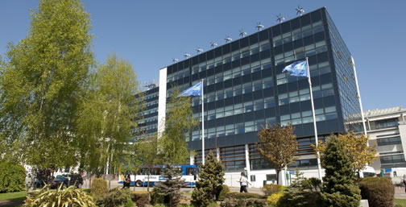
Academic Integrity, Plagiarism avoidance and referencing
Dr S D Sivasubramaniam [Dr Shiva]
Head of Biomedical and Natural Sciences
s.sivasubramaniam@derby.ac.uk

Slide 2
What is Integrity?

Slide 3


How many of you wash your hands, after your each toilet visit?

Slide 4

Vickie Milazzo (2015) Vickie’s Legal Nurse Consultant Bloghttps://www.legalnurse.com/legal-nurse-consulting-blog/2015/04/thoughts-for-success-do-the-right-thing-when-no-one-is-looking

Slide 5
Academic Writing
Providing some new information
Re-evaluating or re-interpreting existing information or concepts
Analysing ideas or concepts or information
Presenting a new way of looking at something
Making a new argument
Contributing something that wasn’t there before
Being honest and transparent – being open to challenge

Slide 6
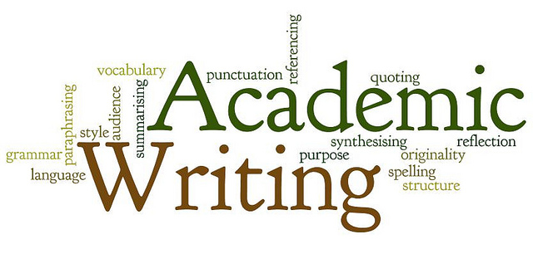

Slide 7
What is plagiarism?
‘an attempt to gain advantage for yourself –
- academic advantage,
- financial advantage,
- professional advantage,
advantage of publicity
by trying to fool someone into thinking that you
- wrote something,
- thought something,
-or discovered something
which in actual fact, someone else wrote, thought, or discovered.’
- [Mc Naughton, 1995]

Slide 8




Types of plagiarism
Copying from others on same course
Copying from an external source – book, web etc.
Copying paragraph(s) and then changing words/word order – “Patch working”
Copying/reusing your own work submitted elsewhere
Buying essays from “essay mills” (Ghost writers)

Slide 9
Pre-session assessment
4. If you use a few lines from another person, you should enclose the lines in quotes, use an in-text citation and cite the source in your Bibliography or reference section.
Is it true or false?
3.Using photographs, video or audio from online or other sources without permission or acknowledgement is plagiarism.
Is it true or false?
1.Going online and copying selected portions of others' works as long as you change a few words IS NOT considered plagiarism and you DO NOT have to reference it.
Is it true or false?
2.Writing about commonly held beliefs or specific facts that are common knowledge without documentation/acknowledgement.
Is it plagiarism?
5.You write part of an essay in your own words and then add in sentences and phrases from an undocumented source.
Is it plagiarism?

Slide 10
How to avoid plagiarism?
Read the source and fully understand the subject
Take short notes from the source and then write in your own words.
Give credit to the original source by giving the authors details at the end.
Diagrams/tables/figures from other sources should be acknowledged.
DO NOT cut and paste sentences from the internet and rearrange them.
DO NOT make slight variations in the language and then fail to give credit.

Slide 11
Source 1:
“The interior of the cell is divided into the nucleus and the cytoplasm. The nucleus is a spherical or oval shaped structure at the centre of the cell. The cytoplasm is the region outside the nucleus that contains cell organelles and cytosol, or cytoplasmic solution.”
From:
Molecular Biology of the Cell: the Problems Book - by John Wilson, Tim Hunt, 1997

Slide 12
Source 2:
“Inside the cells there are many organelles. By definition, organelles are the membrane-bound structures in a cell. The nucleus is an example. Other organelles are located in the cytoplasm such as mitochondria, chloroplasts, endoplasmic reticulum, Golgi apparatus, peroxisomes, lysosomes, vacuoles and glyoxisomes.”
From:
The Cell: A Molecular Approach – by Geoffrey M. Cooper & Robert E. Hausman, 2003

Slide 13
Student work:
Cell is divided into (a) spherical shaped nucleus which usually lies in the centre and (b) the region surrounding the nucleus called cytoplasm. Cytoplasm is mostly filled with water. It also contains organelles such as mitochondria, chloroplasts, endoplasmic reticulum, Golgi apparatus, peroxisomes, lysosomes, vacuoles and glyoxisomes (Wilson and Hunt, 1997; Cooper and Hausman, 2003)

Slide 14
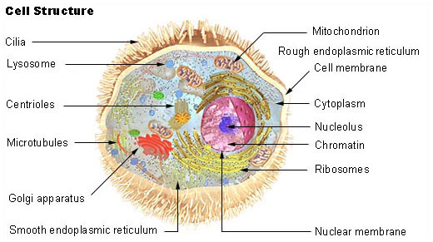
Figure adapted from:
http://training.seer.cancer.gov/module_anatomy/unit2_1_cell_functions_1.html

Slide 15
Use of quotations:
According to International Association for the Study of Pain (IASP, 2006), pain is defined as “psychical adjunct of an imperative protective reflex”
Alternatively;
Pain is considered as a protective mechanism which involves spinal reflex (IASP, 2006)

Slide 16
How to reference?

Slide 17
The Harvard System of Referencing
  An in-text reference to show that a piece of information, idea, quotation, etc. you have included in your writing belongs to another writer.
  Where there is one author – (Bloggs, 2007)
  Where there are two authors – (Bloggs and Bins, 2007)
  Where there are three or more authors - the use of et al - (Bloggs et al, 2007)
e.g: Cell is divided into (a) spherical shaped nucleus which usually lies in the centre and (b) the region surrounding the nucleus called cytoplasm (Selvendran and O’ Neill , 1985; Cosgrove et al, 2001)
Reference: GIVE THE FULL BIBLIOGRAPHIC INFORMATION
Selvendran C and O’Neill S (1985) Isolation and analysis of cell walls from plant material. In Methods of Biochemical Analysis (Glick ed) Vol 32, John Wiley pp 25-133.
2. Cosgrove CD, Carpita Y and Gibeaut KT (2001) Cell structure and cell loosening. A look backwards and forwards. Plant Physiol.,125, 131-134.

Slide 18
APA (American Psychological Association) style of Referencing
  A variant on Harvard style.
  Most of the conventions are the same, with brief author-date citations in brackets.
  With a full citations in the reference list
  Where there is one author – (Bloggs, 2007; p 28)
  Where there are two authors – (Bloggs and Bins, 2007; p52)
e.g: Cell is divided into (a) spherical shaped nucleus which usually lies in the centre and (b) the region surrounding the nucleus called cytoplasm (Selvendran and O’ Neill , 1985- p 32; Cosgrove et al, 2001- p67)
Reference: GIVE THE FULL BIBLIOGRAPHIC INFORMATION
Selvendran C and O’Neill S (1985) Isolation and analysis of cell walls from plant material. In Methods of Biochemical Analysis (Glick ed) Vol 32, John Wiley pp 25-133.
2. Cosgrove CD, Carpita Y and Gibeaut KT (2001) Cell structure and cell loosening. A look backwards and forwards. Plant Physiol.,125, 131-134.

Slide 19
APA: the BPS Style Guide
The APA Style website: http://www.apastyle.org/
Including an audio-enhanced presentation, introducing the basics of APA style (20 mins – for the referencing guidance, go to slides 13-25): http://flash1r.apa.org/apastyle/basics/index.htm
Downloadable from http://www.bps.org.uk/publications/policy-and-guidelines/general-guidelines-policy-documents/general-guidelines-policy#styleguide
In the Course Resources folder for this session
Look for section 9 ‘Citation of sources’ (pages 31-43)

Slide 20
The Vancouver System of Referencing
  A numbering system to show that a piece of information, idea, quotation, etc. you have included in your writing belongs to another writer.
  Give numbers to each reference and the bibliographic details are given in the reference section.
  No need to worry about “how many authors”
  Need to put the same number every time you repeat the same reference.
e.g: Cell is divided into (a) spherical shaped nucleus which usually lies in the centre and (b) the region surrounding the nucleus called cytoplasm ^{1, 2}
Reference: GIVE THE FULL BIBLIOGRAPHIC INFORMATION
1. Selvendran and ONeill (1985) Isolation and analysis of cell walls from plant material. In Methods of Biochemical Analysis (Glick ed) Vol 32, John Wiley pp 25-133.
2. Cosgrove, Carpita and Gibeaut (2001) Cell structure and cell loosening. A look backwards and forwards. Plant Physiol.,125, 131-134. ¹

Slide 21
Turnitin® Text matching software!
Uses algorithm to compare and match information between reports and previously published article.
Scores are given from 0 to 100% for text matches.
These scores are “guidelines only”; A high score does not mean plagiarism.
Final decision will always be taken by the academics

Slide 22
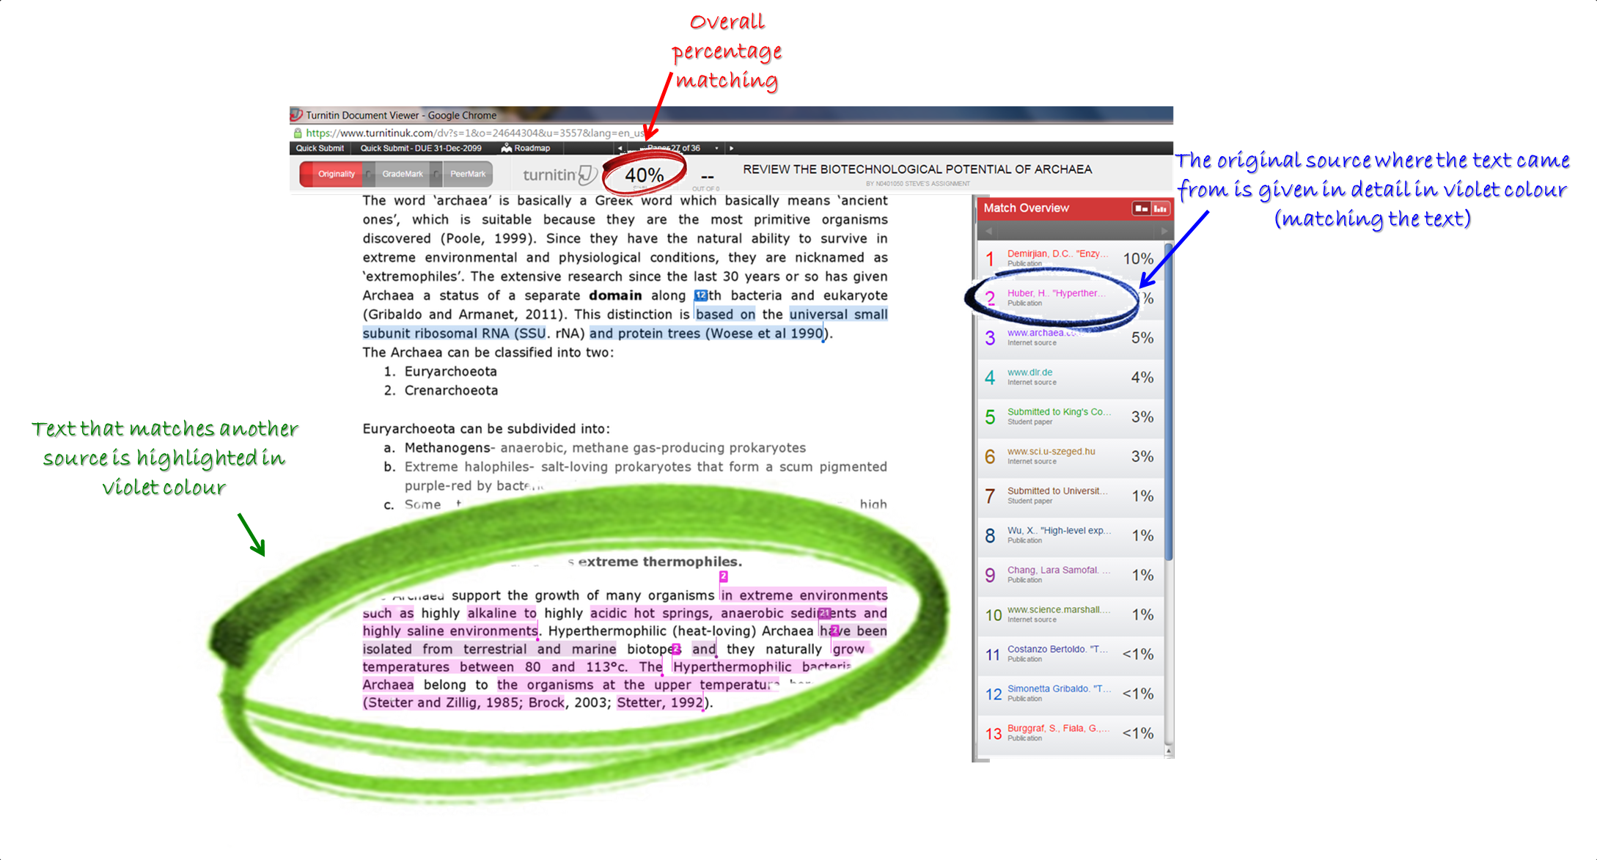

Slide 23
Directed study and tutorial exercise
Plagiarism, paraphrasing and summarising: an exercise from the University of Southern Mississippi (http://www.lib.usm.edu/legacy/plag/paraphrasing.php)
Download the exercise worksheet from the folder for this session in Study Materials. Read the original passage from Nickerson’s article and the three examples of text referring to it. For each example, prepare answers to the following questions:
Is it plagiarism?
How much of the original words and phrases are used?
Is it clear how much is being credited to Nickerson?
How well have Nickerson’s ideas been re-worded or re-phrased into the writer’s own words?
How successful a paraphrase of the original piece is it?
How effective a summary of the original piece is it?

Slide 24
Useful web sites
PLATO (PLAgiarism Teaching Online) course: https://plato.derby.ac.uk/start/
A site at the Open University with advice on writing and assessment generally: http://www.open.ac.uk/study-strategies/
A site at the University of Teesside with a wide range of advice on essays, exams, academic writing and plagiarism: http://dissc.tees.ac.uk/
The Royal Literary Fund’s essay writing advice: http://www.rlf.org.uk/fellowshipscheme/writing/essayguide.cfm
A guide to using English for academic purposes: http://www.uefap.com/vocab/vocfram.htm
The Institute of Education’s site with advice on writing essays, reports, critical reviews and dissertations: http://www.ioe.ac.uk/caplits/writingcentre/index.htm
Write Now, a web site for students devoted to writing for assessment: http://www.writenow.ac.uk/
The University of Manchester’s Academic Phrasebank: http://www.phrasebank.manchester.ac.uk/

Slide 25

https://www.academicintegrity.eu/wp/

