Slide 1
The higher the risk, the higher the profit?
Real-life example O2-B-9-en
PART A

Slide 2
About this document
This document is a real-life example illustrating importance of the values of academic integrity in professional life.
It was created as a part of Toolkit for cross-sector cooperation in terms of academic integrity within Erasmus+ project.
It is a ready-to-use case study accompanied with didactic notes and discussion questions and/or other tasks for the audience.
Find more case studies in ENAI database of educational materials.

Slide 3
Yu-jin was always living in the shadow of her brother who was identified as a math prodigy from his early years. At school, she was mirroring his achievements; albeit she neither received the same recognition, nor praise. This fact made her try even harder.
When she had to select a major at the University, she selected Finance mirroring her brother’s specialization.

Slide 4
During her studies, her brother got a job in an international Bank. Often, he was bragging about his work that required to access financial databases and apply complex financial models on data series.
Challenged by such descriptions, Yu-jin started experimenting with financial modeling and analysis early on, well ahead of her peers. She became an expert in no time.

Slide 5
Through her brother’s professional account Yu-jin had access to financial data regarding publicly listed companies as well as to financial analysis reports for companies and industry sectors. Such analysis was often required in her term projects.
Yu-jin could complete excellent reports for her assignments within minutes; a typical student would have had to devote numerous hours to compile the same report.
Word spread around. Yu-jin received many requests for help. She agreed to comply to each one of them under one condition: they promised to vote for her for the position of the President of the Business Society.
When she got elected, Yu-jin achievement surpassed those of her brother for the first time. History was made.

Slide 6
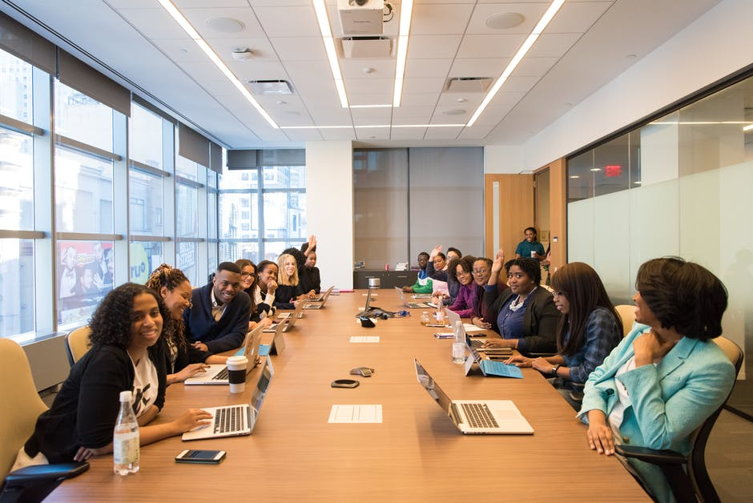
In her capacity as President of the Business Society, Yu-Jin was invited to participate in many academic bodies and was introduced to representatives from the industry. She became aware of cutting edge developments and developed an extensive network of acquaintances from practically all companies affiliated with the University. Early on, she realized that this social capital will contribute to her professional advancement and pay dividends.

Slide 7
In 2013, she was one of the first at the University to learn about blockchain technologies and cryptocurrencies. She could identify some positive prospects of cryptocurrencies and more specifically Bitcoin. Her petty cash, about 1,100 USD, could buy 100 Bitcoins at that time. She wondered whether to invest or not.

Slide 8
Her brother had developed a risk aversion attitude partially due to his conservative professional environment. Thus, he warned her against such investment. She counter argued that the invested money was so little that she could afford to lose it. Furthermore, she pointed out, that if it worked it would have huge returns. She became the first investor in Bitcoin from her class.

Slide 9
For the next few years, Bitcoin was traded in the region of 200 Euros. During that time, Yu-jin became more and more passionate about cryptocurrencies’ future role in finance as well as in other industry sectors.
She enjoyed high visibility and popularity within the cryptocurrency community. In June 2017, Yu-jin graduated with her MBA degree with the highest distinction, while by the end of the same year Bitcoin soared to ~19,000 Euros. Yu-jin excelled academically and she became a freshly-minted millionaire.
Yet another first!

Slide 10
Conclusion
Yu-jin has an inquisitive mind that has lead her well beyond her comfort zone and enabled her to explore new technologies and applications.
She gets personal satisfaction from being a pioneer; she has secured considerable return on her investments.
It seems that she lives by “The higher the risk, the higher the profit”.

Slide 11
Discussion

Slide 12
Questions - Activities
Did you identify anything illegal so far? If yes, please explain.
Did you identify anything unethical? If yes, please explain.
What would you do if you were in Yu-jin’s position?

Slide 13
Social comparison might put pressure in one’s personal and professional life, however integrity and ethics should be followed.
Integrity and ethical practices need to be maintained in every aspect of life.

Slide 14
Acknowledgement – pictures source
All photos used are just illustrative, they are downloaded from an online photo-bank and the people depicted have no connection with the presented story.
Author: Pexels
Licensed under https://www.pexels.com/photo-license/
Source: https://www.pexels.com

Slide 15
Authors
Prof. Angelika Kokkinaki (kokkinaki.a@unic.ac.cy )
Dr. Stella Kleanthous (kleanthous.s@unic.ac.cy )
With contribution by Dr. Ifigenia Georgiou (georgiou.i@unic.ac.cy )
The case was written and piloted in 2018 and finalized in 2019

Slide 16
License Information
Title of the work: “The higher the risk, the higher the profit? Part A”
Attribute work to name: Angelika Kokkinaki and Stella Kleanthous Licensed under: creativecommons.org/licenses/by/4.0
Attribute using following text:
“The higher the risk, the higher the profit? Part A” by Angelika Kokkinaki and Stella Kleanthous is licensed under a Creative Commons Attribution 4.0 International License.

