Slide 1
Once a hacker, always a hacker!
Real-life example O2-B-8-en

Slide 2
About this document
This document is a real-life example illustrating importance of the values of academic integrity in professional life.
It was created as a part of Toolkit for cross-sector cooperation in terms of academic integrity within Erasmus+ project.
It is a ready-to-use case study accompanied with didactic notes and discussion questions and/or other tasks for the audience.
Find more case studies in ENAI database of educational materials.

Slide 3
Andrew was a shy, intelligent boy from a working class family who had a keen interest in computing. At school, he was bullied by his classmates for being a geek. Despite that, or perhaps because of it, he believed that his competencies in computing would eventually provide for a meaningful life.

Slide 4
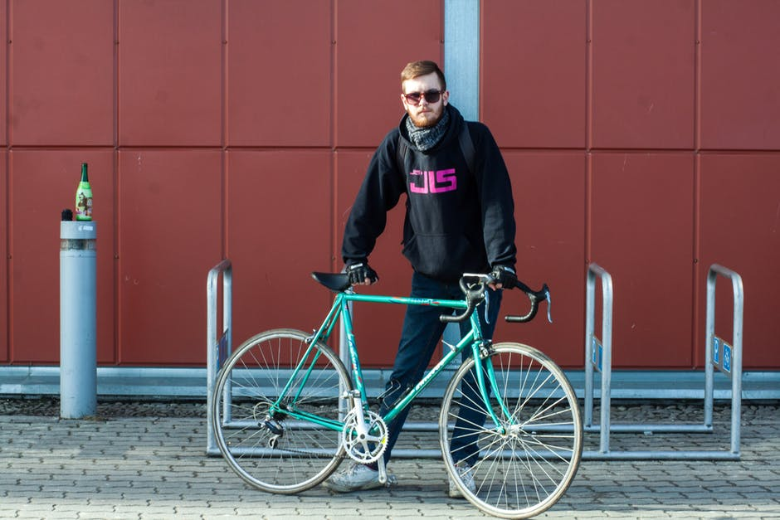
Andrew applied to a number of internationally recognized Universities. He selected the one that offered him the most appealing scholarship; in return he had to maintain an excellent GPA and work as an assistant in the Computer Center of the University.
Andrew did very well in his studies. Expenses were substantial and his scholarship covered just the basics. Andrew was left with a lot to be desired; not to mention that, he -once again- felt socially marginalized.

Slide 5
His part-time job gradually became more challenging. Most issues could be resolved remotely, some entailed visits to the offices.
The most noteworthy incident was when he was summoned to the office of the Moodle Administrator of the University. Andrew noticed that the Administrator - bridging security guidelines- had written down his password for his Moodle account in his notepad next to the computer.
Andrew memorized the credentials while working to resolve the problem.

Slide 6
Andrew was intrigued to be able to have the rights and privileges of the Moodle administrator. Moodle was used as the platform that supported all courses of the university. When he logged in using the credentials of the administrator, Andrew realized that this was a super-user account, which provided him the right to:
change deadlines for homework submissions;
view files (i.e. quizzes, tests, solutions etc) that were hidden from students;
change grades for homework assignments or projects.
In a flash, he realized that having such access would help him earn money as well as recognition among his fellow students.

Slide 7
He started by enabling students to submit their work after the deadline set by the faculty without being signaled out by the system as late submissions.
Essentially, he was granting students extensions as if he was their lecturer. Beyond the empowerment he felt, he also received a modest fee for each extension.

Slide 8
The next step was to sell questions that “were likely to appear in exams” to students. The questions were found from the hidden files. Whenever available, he would also provide exemplary answers.
Although he could change grades for any student he reserved this privilege only for himself, only for the courses that he believed he was graded properly.
The risks were high; he was extremely careful. He changed grades during holidays or a few days before the Board Examinations of the University, when it was highly unlikely to be noticed. Indeed, nothing had been detected.

Slide 9
Boosted by improved grades, he was awarded his degree with the highest distinction.
Upon his graduation, Andrew had developed unprecedented popularity among his peers. Furthermore, the extra cash earned helped him overcome many difficulties in his personal finances.
Based on his excellent academic credentials and his work experience in the University Computer Center, he secured a systems developer position in a Bank in his home country.

Slide 10
Andrew started working in the IT Department of the Bank. He liked his job. He particularly enjoyed the seminars he had to attend in his new role.
Soon, he became fully aware that the security mechanisms of the Bank were outstanding with special provisions for detecting IT related frauds. Any deviant behavior of the past did not have place in his current undertakings he believed. He did not want to jeopardize his career.

Slide 11
In the Bank’s annual gala dinner he met Maria a fellow co-worker from Private Investment Department. They hit it off instantly.
Having similar priorities in life, they married and within a few months they were expecting their first child.
For Andrew, hacking was a thing of the past. He now felt fulfilled.

Slide 12
Life seemed perfect for a while. But starting 2009, a financial crisis hit the country.
Many (including Andrew and Maria) suffered severe pay cuts.
Andrew once again felt that he was a special case and the severity measures should not apply for him.

Slide 13
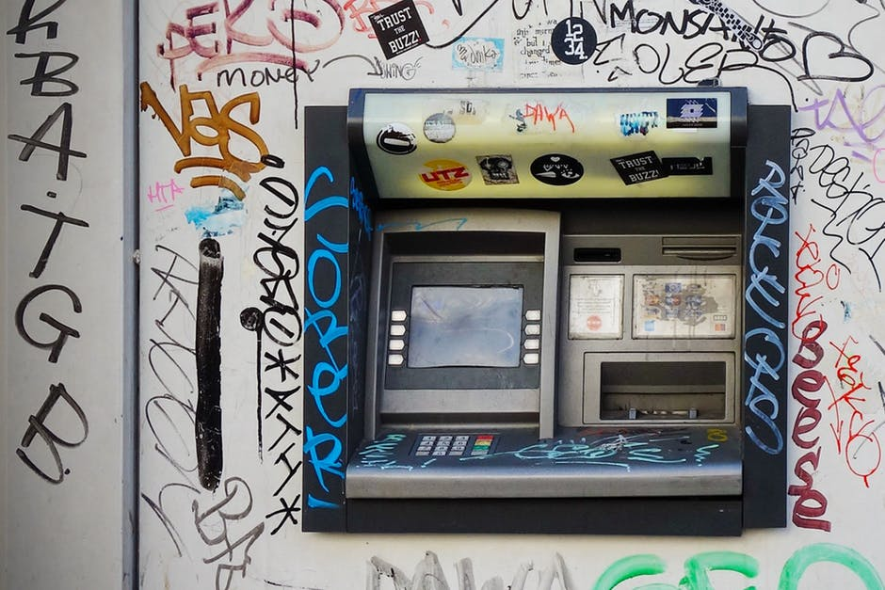
The crisis escalated and capital controls were imposed and one could only withdraw up to 100 EUR daily.
This resulted into a need among account holders -especially those with high deposits- to transfer their money abroad.
With all formal channels for transactions blocked, Andrew identified a unique opportunity. He could enable account holders transfer money abroad and save their accounts from “leveling”.

Slide 14
No one -except Andrew- can really tell how much he was paid for each transfer completed.
He demanded and received exceptionally handsome rewards for each transfer of funds to overseas accounts.
Rumors had it that he amassed over 5M EUR within a couple weeks.

Slide 15
Andrew being overconfident for his “achievement” flashed his newly acquired wealth. During the crisis, his outrageous purchases had a big impact.
His employer launched an inquiring committee and on the preface of a task that was delayed to be completed he got fired. His wife was found to be redundant and was offered an exit package.
It was widely believed that these were simply pretexts for his rumored defiance that could not be adequately substantiated. Once again Andrew and his family were marginalized.

Slide 16
The conclusion
After having lost their jobs, neither Andrew nor Maria were able to find a job in a crisis stricken country; they had to move to another country.
They faced many challenges in their transition from well-established professionals into wealthy (yet marginalized) immigrants.
They also realized that long-term professional success is tightly connected to good work habits and ethics.

Slide 17
Discussion

Slide 18
Questions – Activities
Identify the safety instructions regarding password use at your University.
How do you assess Andrew’s “pseudo-integrity” with regards to the selective application of his ability to change grades only in classes he thought he was not fairly graded?
Discuss in class precautions that need to be followed to improved security at work.
What sort of academic dishonesty one can attribute to Andrew?
Do you believe that Andrew acted unethically when he helped his customers save their money? Please, explain.

Slide 19
Anchor to the real case
The case study was based on inside information about a software engineer in a Financial Institution during the financial crisis in Cyprus, in 2013.
The case was not publicly disclosed.
Notes:
Optional part

Slide 20
Message of the story
Unethical behaviour during university can lead to similar behaviour in professional life, usually with much worst consequences
Ethics and integrity must be nurtured and developed early on in academic development

Slide 21
Acknowledgement – pictures source
All photos used are just illustrative, they are downloaded from an online photo-bank and the people depicted have no connection with the presented story.
Author: Pexels
Licensed under https://www.pexels.com/photo-license
Source: https://www.pexels.com

Slide 22
Acknowledgement – storyline
The incidence with the careless Moodle Administrator occurred in a University.
The student infiltrating e-learning courses was brought to a Disciplinary Committee.
Bank employees were investigated with regards to illegal transfer of funds abroad during a capital control situation.
Not all of the above concern the same person.

Slide 23
Responsible authors
Angelika Kokkinaki (kokkinaki.a@unic.ac.cy)
Stella Kleanthous (kleanthous.s@unic.ac.cy )
With contribution by Dr. Ifigenia Georgiou (georgiou.i@unic.ac.cy )
2018

Slide 24
License Information
Title of the work: “Once a hacker, always a hacker”
Attribute work to name: Angelika Kokkinaki & Stella Kleanthous Licensed under: Creative Commons Attribution-ShareAlike 4.0 International License.
Attribute using following text:
“Once a hacker, always a hacker” by Angelika Kokkinaki & Stella Kleanthous is licensed under a CC-BY-SA license (https://creativecommons.org/licenses/by-sa/4.0/).

