Slide 1
Lesson about educating plagiarism deterrence to International students

Slide 2
About this document
This document is a real-life example illustrating importance and the values of academic integrity in professional life.
It was created as a part of Toolkit for cross-sector cooperation in terms of academic integrity within Erasmus+ project.
It is a ready-to-use case study accompanied with didactic notes and discussion questions and/or other tasks for the audience.
Find more case studies in ENAI database of educational materials.

Slide 3
Target audiences
Academics
Course leaders
Plagiarism prevention officers
Post-graduate students
Undergraduate students
Postgraduate students

Slide 4
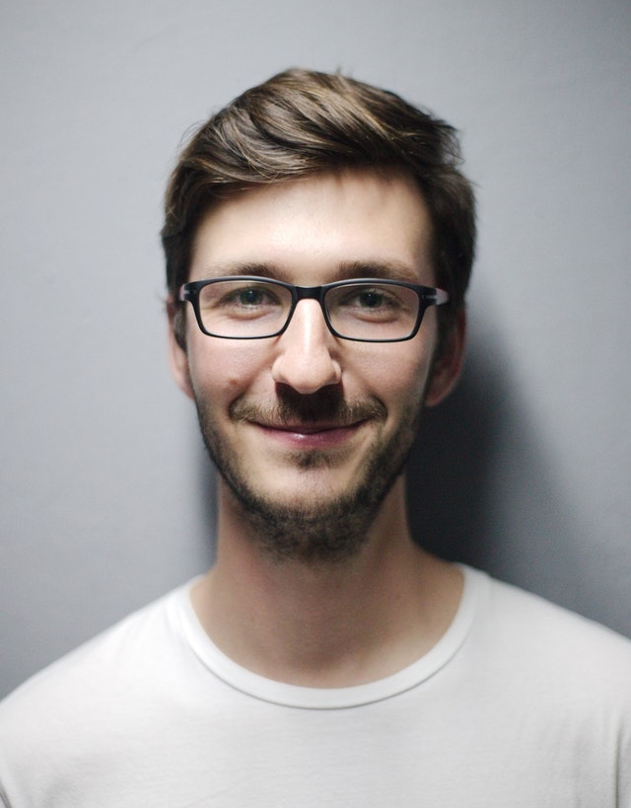
Dr Mario Kassar
An enthusiastic newly appointed lecturer
He was made to lead an MSc module in biomedical science.
As an innovative lecturer, he has transformed the assessment from formal exam into online open book test
Notes:
Source: https://www.pexels.com/photo/adult-beard-boy-casual-220453/

Slide 5
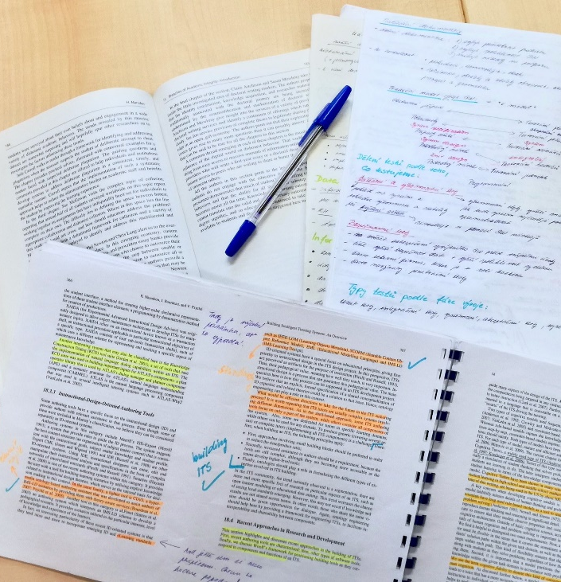
Open-book test – definition
Innovative assessment methodology
Each question is timed and students should answer that question within that allocated time
Students are allowed to take short notes to the test but the questions are usually formed in such a way an knowledge application (rather than copying notes) is needed
Notes:
Photo by Dita Dlabolová

Slide 6
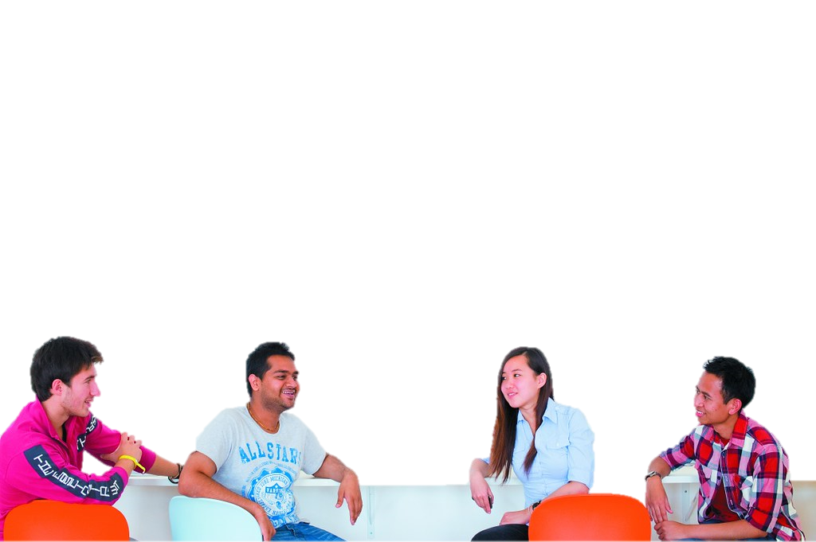
Students taking Mario’s module
The module is taken by a variety of students.
50% them are international students
They are mainly from Middle-Eastern, Western African and South-East Asian counties.
All students were made to attend a compulsory academic integrity workshop.
Notes:
"International Students" by uonottingham is licensed under CC BY-NC-SA 2.0
Source: https://www.flickr.com/photos/36509015@N08/6673166113

Slide 7



Academic integrity workshop – Summary
The workshop explored the different types of academic irregularities such as:
Cheating in class, assignments and exams
Trying to bribe to achieve academic advantage
Misrepresenting facts, figures, data or individuals
Fabricating results, information or data
Conspiring to deceive in assignments and examinations
Colluding with another student(s) with the aim to cheat.
Duplicating one’s own submissions with the intention to cheat
Not abiding with IT services code of conduct
Improper use of online resources
Plagiarism with or without intention (in detail)

Slide 8
Mario’s University regulations – Summary
Students are expected to:
Present truthful and accurate data or facts and research information in academic assignments.
Completing exams and other academic assignments in an honest way.
Properly acknowledge extra help obtained from persons, books, articles and other sources, and avoid plagiarism by properly incorporating these sources

Slide 9
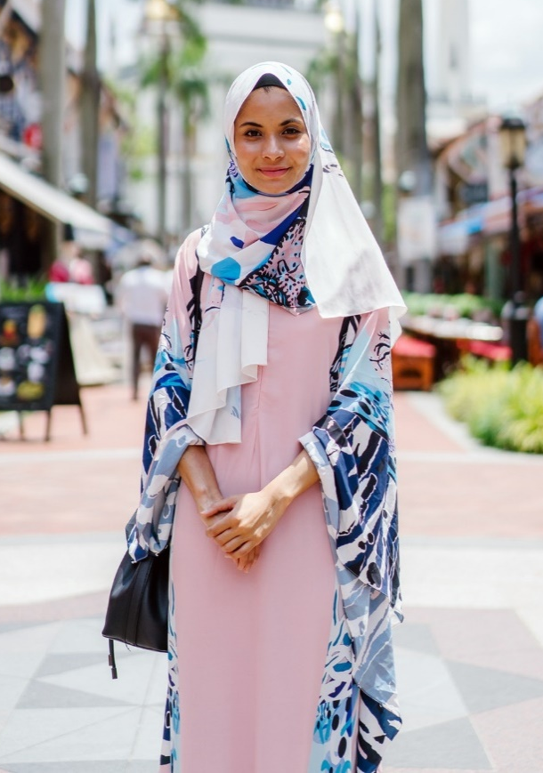
Fatima Al-Zharanai
An international student who is used to different form of academic writing and to traditional examination
Obtained very high exit marks in all her undergraduate subjects
This is her first course outside her country
Attended the academic integrity workshop and clarified her doubts about plagiarism
Notes:
Photo by mentatdgt from Pexels
Source: https://www.pexels.com/photo/woman-wearing-hijab-and-abaya-dress-while-standing-with-mosque-as-background-1162890/

Slide 10
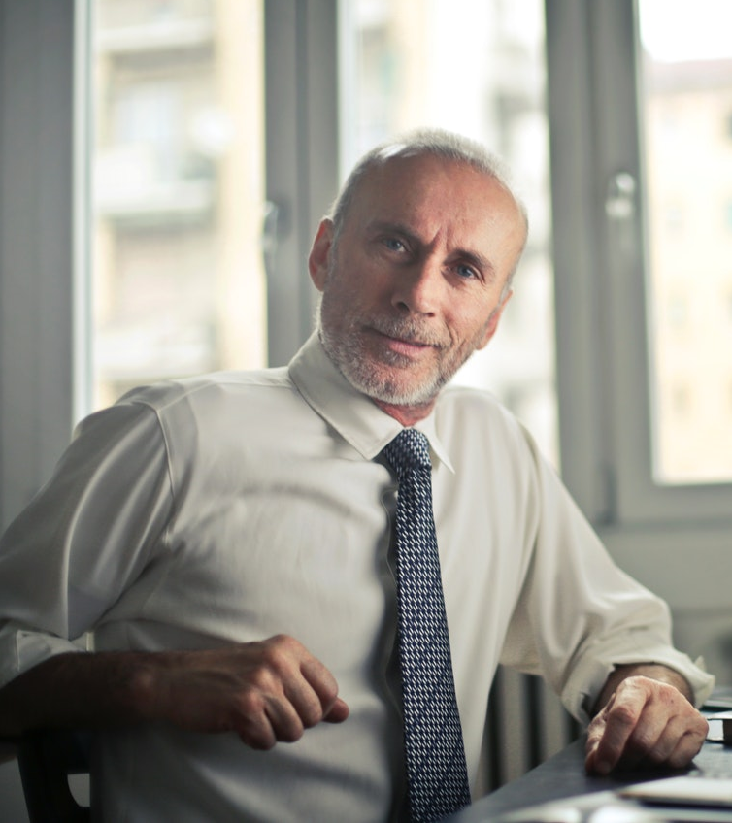
Dr Das
Academic integrity officer
His main roles include:
    Plagiarism deterrence,
    Educating students on academic integrity
    Handling alleged plagiarism offenses
    Recommending appropriate actions/penalties to academic offenses.
    Act as an intermediary between students and academics to solve, integrity related matters
    He has the authority instruct academics in matters relating to integrity
Notes:
Photo by bruce mars from Pexels
https://www.pexels.com/photo/man-sitting-on-chair-beside-table-834863/

Slide 11


Fatima and the academic integrity officer
Fatima: “Sir, I am bit confused about plagiarism practices under exam conditions.”
Das: “Ok ask me your doubts, I will try to clear them as much as I can. By the way, you can call me Das.”
Fatima: “Sir! Suppose I memorise a paragraph word-for-word and reproduce it under the formal exam condition – would it be considered as plagiarism.”
Das: “Well although you are simply reproducing another person’s work, if it is under exam condition and you write them from your memory, it cannot be considered as plagiarism.
However, in actual fact you are plagiarising. Also, at MSc level, situation like these are rare because the questions are formulated for you to apply the knowledge rather than reproducing them.
Again, please call me Das, here no one is called sir!”
Notes:
Fatima - Photo by mentatdgt from Pexels
Source: https://www.pexels.com/photo/woman-wearing-hijab-and-abaya-dress-while-standing-with-mosque-as-background-1162890/
Dr Das - Photo by bruce mars from Pexels
https://www.pexels.com/photo/man-sitting-on-chair-beside-table-834863/

Slide 12

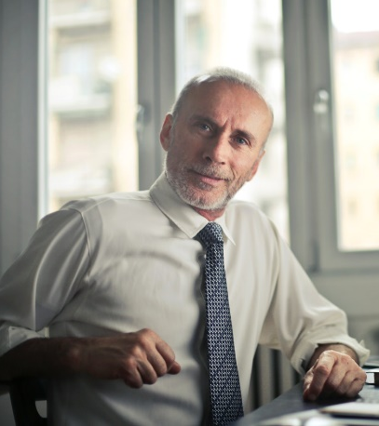
Fatima and the academic integrity officer
Fatima: “But Sir, in my country I am used to memorise and reproduce without looking the original and we receive high marks for doing this for examination.”
Das: “But that is considered as superficial learning. I do not think you would have similar expectation here.”
Fatima: “Sir! I got another question – what is an open book test?”
Das: “As I already told you, here we expect the students to apply their knowledge. So in some module exams, we allow the students to take their short notes to the exam hall, BUT expect them to use their notes and elaborate their answers. It is a form
of applying knowledge
Fatima: “So I can copy that notes? Am I right, Sir?”
Notes:
Fatima - Photo by mentatdgt from Pexels
Source: https://www.pexels.com/photo/woman-wearing-hijab-and-abaya-dress-while-standing-with-mosque-as-background-1162890/
Photo by bruce mars from Pexels
https://www.pexels.com/photo/man-sitting-on-chair-beside-table-834863/

Slide 13

Fatima and the academic integrity officer
Das: “NO! Fatima, I do not think you can pass the test just by reproducing. You need to critically elaborate your short notes to suit the question.”
Fatima: “Sir! I am still confused, so am I not allowed to use my short notes?”
Das: “Well, yes you are allowed to use the short notes as long as they were elaborated and transformed to suit the question.”
Fatima: “Thanks ever so much, Sir! You have been really helpful, Sir!
I asked the same questions to Dr Mario, Sir, but he said go to the library and learn!”
Das: “Well he may be busy when you approached. Anyway, I am happy that you are now cleared your doubts.
But please stop calling us ‘Sirs’.”
Fatima: “But Sir…I mean Das, it is embedded in our culture.”
Notes:
Fatima - Photo by mentatdgt from Pexels
Source: https://www.pexels.com/photo/woman-wearing-hijab-and-abaya-dress-while-standing-with-mosque-as-background-1162890/
Dr Das
Photo by bruce mars from Pexels
https://www.pexels.com/photo/man-sitting-on-chair-beside-table-834863/

Slide 14
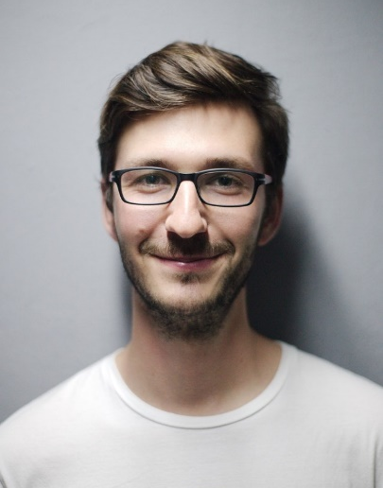
Academic integrity officer Vs. Dr Mario
After this conversation Dr Das send an internal memo to Dr Mario:
explaining his conversation with Fatima
asking Dr Mario to help her with preparing the open book test.
Instructing him to produce applied questions
Prof Mario sends a strong email back saying:
“That is not my job!”
Notes:
Dr Mario - Source: https://www.pexels.com/photo/adult-beard-boy-casual-220453/
Dr Das Photo by bruce mars from Pexels
https://www.pexels.com/photo/man-sitting-on-chair-beside-table-834863/

Slide 15
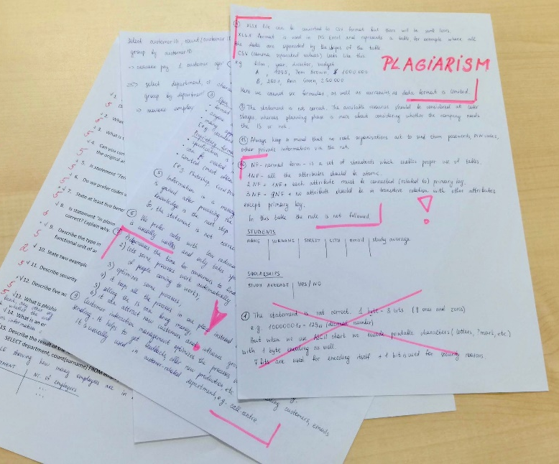
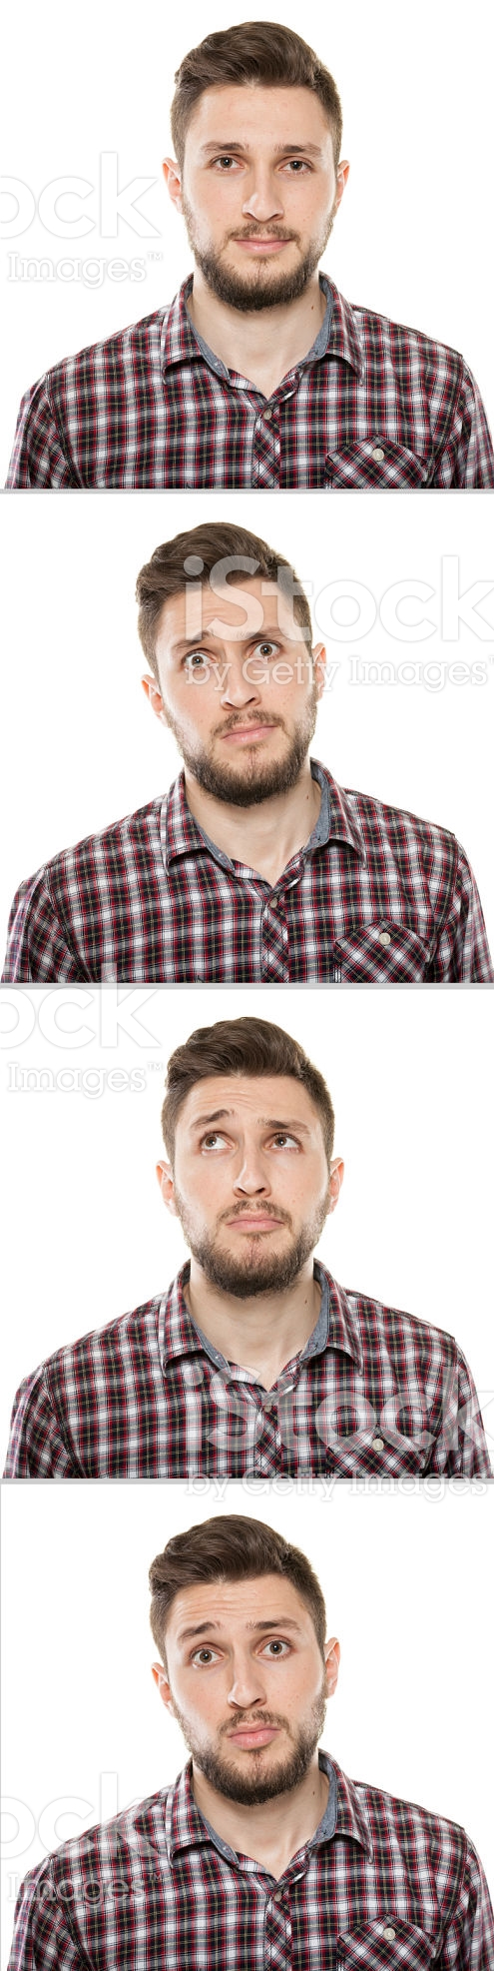
After the open-book test
Dr Mario detects several plagiarised answers in Fatima’s open-book answers!
He decides to send to academic investigation which is carried out by Dr Das and other senior managers.
Dr Das was amazed to see that most of Mario’s questions can be answered directly from books!
Notes:
Photo by Dita Dlabolová

Slide 16
The Aftermath!
Fatima was really upset and she wanted to have a private meeting with Dr Mario.
Her request was ignored by Dr Mario.
She then complained to her embassy as she has been racially targeted.
Her embassy lodged an official complaint against Dr Mario.
Notes:
Photo by mentatdgt from Pexels
Source: https://www.pexels.com/photo/woman-wearing-hijab-and-abaya-dress-while-standing-with-mosque-as-background-1162890/

Slide 17

Extra points to ponder
After the initial conversation with Fatima, Dr Das has officially informed Dr Mario about this.
He also asked Dr Mario to make sure to give the maximum advise and support about the “open-book online test”.
Other students have also complained about Dr Mario’s inability to explain about the format of the “open-book online test” and his inability to clarify things.

Slide 18
Consequences
Dr Mario is under suspension and facing internal “gross misconduct” investigations.
Notes:
Source: https://www.pexels.com/photo/adult-beard-boy-casual-220453/

Slide 19
Discussion
Do you think Fatima’s behavior is acceptable?
Did you find any mitigating circumstances for Fatima’s behavior in the story?
What do you think about the influence of Fatima’s culture on her education?
Does Dr Mario’s suspension justifiable, if not whom do you think should be punished?
What could have been done to prevent the problem?
What may be the cause of this problem?

Slide 20
Discussion
Do you think Fatima’s behavior is acceptable?
Did you find any mitigating circumstances for Fatima’s behavior in the story?
What do you think about the influence of Fatima’s culture on her education?
What could have been done to prevent the problem?
How would you explain to Fatima how to answer in the open-book test?

Slide 21
Message of the story
Think about formulating clear instruction about plagiarism deterrence considering students from different backgrounds, culture and countries.
Rules and requirements should be stated clearly.
Be careful how you put into practice good ideas.
Avoid using obvious questions or re-using past paper questions

Slide 22
Message of the story
Thou shall never commit no plagiarism in an open-book test!

Slide 23

Anchor to the real case
This is a true story that happened in one of author’s previous universities which has high number of international students.
The issue was resolved by rearranging the open book test but the embassy has stopped sending students to that university.
After this incidence the university has taken initiatives to re-educate academics about “culture related issues” that affect academic integrity

Slide 24
Responsible author
Dr S D Sivasubramaniam, Univeristy of Derby (s.Sivasubramaniam@derby.ac.uk)
2018
Disclaimer: This real life example has not happened in University of Derby!

Slide 25
Photo credits
All photos used are just illustrative, and the people depicted have no connection with the presented story.
https://www.pexels.com/photo/adult-beard-boy-casual-220453/
“Open-book test” by Dita Dlabolová
"International Students" by uonottingham, source: https://www.flickr.com/photos/36509015@N08/6673166113
“Woman wearing hijab…” by mentatdgt from Pexels, source: https://www.pexels.com/photo/woman-wearing-hijab-and-abaya-dress-while-standing-with-mosque-as-background-1162890/
“Man…” by bruce mars from Pexels, source: https://www.pexels.com/photo/man-sitting-on-chair-beside-table-834863/
“Plagiarism in exam” by Dita Dlabolová

Slide 26

License Information
Title of the work: “Lesson about educating plagiarism deterrence to International students”
Attribute work to name: Sivasubramaniam, Shiva (www.academicintegrity.eu)
Licensed under: Creative Commons Attribution-ShareAlike 4.0 International License
Attribute using following text:
“Lesson about educating plagiarism deterrence to International students” by Sivasubramaniam, Shiva is licensed under a Creative Commons Attribution-ShareAlike 4.0 International License.

