Slide 1
O2C: Academic Integrity
Workshop for secondary school students

Slide 2
Basic information
Target audience: Secondary school students, pre-university
Summary: to help prepare students for university or working life
Objectives: (1) to raise awareness about academic integrity; (2) explore use of sources of information; (3) to explore perceptions on acceptable practices; (4) to improve students’ understanding of academic writing
Length: 90 mins, preferably with a break in the middle

Slide 3
Agenda
What is academic integrity?
Using sources of information
Violations to academic integrity
Responsibilities
Discussion: what should we do about this?

Slide 4
Academic Integrity
What is your understanding of this term?
Honesty, trust, fairness, respect, responsibility, courage (ICAI fundamental values)
Lack of integrity >> quality and standards
Institutional conduct, culture, norms, values
Applies to leaders, teachers, parents, pupils
Oversight, diligence, caring

Slide 5
Using sources of information
Working in small groups, discuss: when writing an essay or finding material for a project
Where do you look?
How do you know the sources are reliable?
How do you use the material you find?
How do you acknowledge your sources?
Notes:
Give the students 10-15 minutes to discuss these points in small groups, then ask each group to feed back their answers to you.
Make clear to them that you want to know what they actually do NOT what they think the right answer should be!
Take notes or ask the groups to take their own notes so you have a record of their ideas.
After the feedback you can show the next 3 slides that provide some guidance.

Slide 6
Using sources - feedback
Where do you look? Internet, magazines, newspapers, text books, academic journals, others?
How do you know the sources are reliable?
Whatever sources you refer to for information, you need to ask/check how accurate or reliable the information is. It is an opinion or is it a statement of fact?
Internet sources such as Wikipedia may not be reliable, you need to take care and not rely only on such sources
Notes:
For general information you may use any source you wish, as long as you are mindful of how unreliable it may be.
However if you are writing for academic purposes, your sources must reflect the standard of work that is expected of you. You should normally refer to scholarly work published in peer reviewed academic journals or academic texts. Some of these are available on-line as e-books and e-journals and generally accessible for free from university libraries.

Slide 7
Using sources - feedback
How do you use the material you find?
Written work
If you text copy verbatim into your own work then you must put quotation marks around the text to show these are not your own words
Even if you paraphrase then this is still not your own work
Graphical content, audio or video
You may need permission to reproduce this – check copyright
Software, programming code
Your assignment is testing your programming skills, therefore using code written by someone else is not normally appropriate
If your teacher has allowed you to reuse code then you need acknowledge the source, eg in comments or Javadoc notes
Notes:
Notes:
Too much copying means that your work is not authentic
Paraphrasing is hard to do – even expert writers find it hard

Slide 8
Using sources - feedback
How do you acknowledge your sources?
Whatever sources you use, paraphrase or adapt in any way must be acknowledged using an appropriate reference
If you quote directly you should also give the page number
Do you need to reference Internet sources?
Yes! All sources must be referenced
Now have a break for 5 minutes before the second half
Notes:
Notes:
There may be questions about referencing styles
Let the class have a

Slide 9
Certainly in a higher education context there are many factors that prevent rapid changes. Kolmos and de Graaff compare the management of a university faculty to “the navigation of a super tanker….The inertia of mass precludes any abrupt change of course” (Kolmos & de Graaff 2007: 35). This analogy clearly reflects the experience of the SEE team.
In-text citation
Kolmos, A., De Graaff, E. (2007). Process of changing to PBL in De Graaff, E. and Kolmos, A. (eds.) Management of Change Implementation of Problem-Based and Project-Based Learning in Engineering, Rotterdam / Taipei: Sense Publishers.
Reference
Notes:
A very brief look at referencing, this example used Harvard style
Other examples of referencing styles are APA, Chicago
At University you are likely to be told which style to use and be given guidance on the formats
There are also software tools and plug-ins to help you keep track and add references

Slide 10
Violations to academic integrity
A few examples:
Plagiarism – ghost writing – essay mills - contract cheating (+ help from friends, family) eg EduBirdie
Using technology to cheat in exams
Students copying from each other (collusion)
Posting questions / answers on line before public exams
False personal statements and references
Teachers giving out exam questions / answers

Slide 11
https://awriter.org/edubirdie-com-review/

Slide 12
https://awriter.org/edubirdie-com-review/

Slide 13
https://awriter.org/edubirdie-com-review/

Slide 14
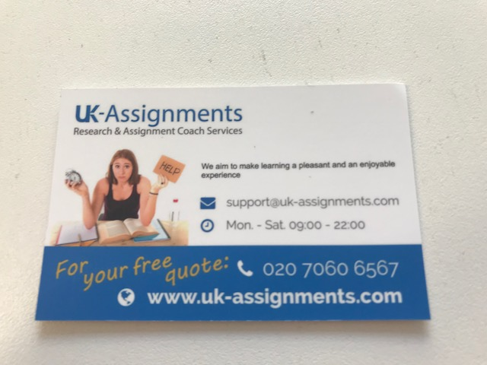
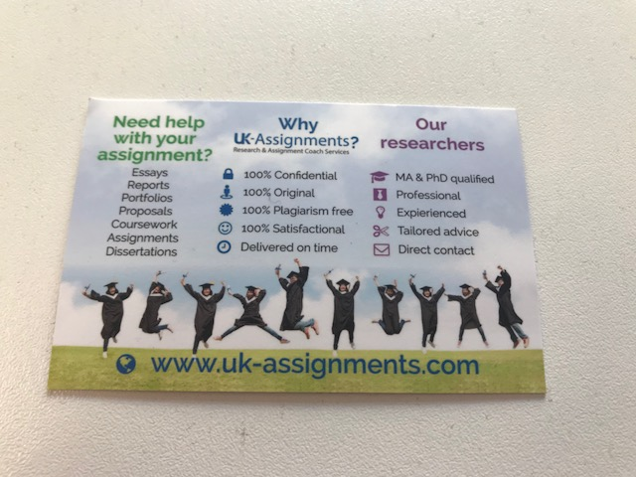
Contract cheating
Students are regularly contacted by “essay mills” via social media, posters, leaflets and cards like this handed out by representatives on university campuses
Notes:
Giving your personal details to these companies can lead to all sorts of on-going problems, for example bribery, passing on your details to other companies.
The quality of work they produce is generally very poor, sometimes late
If you are found to have handed n work you did not do yourself you are likely to be expelled from university

Slide 15
Why is cheating unacceptable?
Discuss these topic in your groups
Who loses out when a student cheats?
What happens if you are caught cheating?
How can we persuade students to be honest?
What relevance has this to working life?
Notes:
Let the groups discuss for about 10 minutes then ask each group to feed back their thoughts

Slide 16
Why is cheating unacceptable?
Who loses out when a student cheats? Everyone – the cheating student does not learn; everyone else’s efforts are devalued if the cheat escapes without penalty
What happens if you are caught cheating? From zero mark to expulsion, depending on how serious
How can we persuade students to be honest? We are working on it!
What relevance has this to working life? Lots! If you cheat during education you are likely to continue to cheat just to get by
Notes:
Some guidance on each of these questions

Slide 17
Summary
Only a small minority of students cheat deliberately
If you don’t know the rules you might accidentally plagiarise
Academic writing skills, referencing and citation, paraphrasing etc.
We work with students as partners to promote academic integrity
Learning is valuable and important for its own sake
Understanding Intellectual Property Rights and Copyright
Assessing the quality of sources and knowing how to use them, including “borrowed” programming code
Use of technology to discourage and identify cheating
Conducting research, raising awareness about academic integrity
Legislation and legal action as a last resort
Notes:
Final slide to summarise to workshop

Slide 18
Follow up
If you are interested in exploring this topic in more depth, then please contact me
ireneg@coventry.ac.uk
Dr Irene Glendinning
Academic Manager for Student Experience
Office of Teaching and Learning
Coventry University

Slide 19
Didactic / teachers notes
Encourage discussion and participation throughout the session
Discuss what counts as common knowledge in different subjects
Suggest they start a conversation about this with their parents, teachers and friends from other schools

Slide 20
Further information
International Center for Academic Integrity (ICAI): https://academicintegrity.org/fundamental-values/
European Network for Academic Integrity (ENAI): https://www.academicintegrity.eu/wp/
All URLs were working on 24th July 2019.

Slide 21
License Information
Title of the work: Avoiding Plagiarism
Attribute work to name: Dr Irene Glendinning
Licensed under: creativecommons.org/licenses/by/4.0
Attribute using following text:
Avoiding Plagiarism by Irene Glendinning is licensed under a Creative Commons Attribution 4.0 International License.

