Slide 1
O2C: Academic Integrity
Workshop for secondary school teachers

Slide 2
Basic information
Target audience: Primary school and secondary school teachers and leaders
Summary: to highlight the need for attention to academic integrity in schools
Objectives: (1) to raise awareness in teachers of the threats to academic integrity; (2) to begin a dialogue about this topic; (3) to capture information about teachers’ perceptions; (4) to improve education for students and teachers on this topic
Length: 50 mins

Slide 3
Agenda
Academic integrity in secondary education
Violations to academic integrity
Responsibilities
Discussion: what should we do about this?
Notes:
Obligatory part

Slide 4
Academic Integrity, secondary
What is your understanding of this term?
Honesty, trust, fairness, respect, responsibility, courage (ICAI fundamental values)
Lack of integrity >> quality and standards
Institutional conduct, culture, norms, values
Applies to leaders, teachers, parents, pupils
Oversight, diligence, caring

Slide 5
Violations to academic integrity
Plagiarism – ghost writing – essay mills - contract cheating (+ help from friends, family) eg EduBirdie
Using technology to cheat in exams
Breaches to integrity in public exams
Plagiarism in personal statements
Teachers giving out exam questions / answers
What other types of violations have you seen?

Slide 6
https://awriter.org/edubirdie-com-review/

Slide 7
https://awriter.org/edubirdie-com-review/

Slide 8
https://awriter.org/edubirdie-com-review/

Slide 9
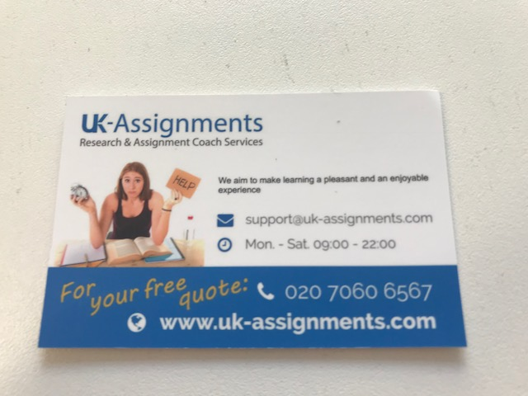
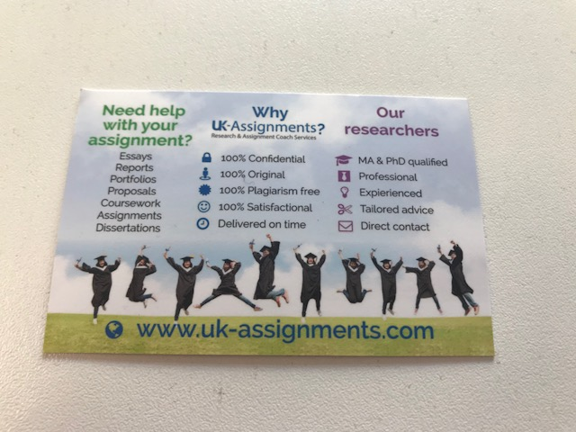
Contract cheating
Students are regularly contacted by “essay mills” via social media, posters, leaflets and cards like this handed out by representatives on university campuses

Slide 10
Responsibilities
Pupils / students
Parents, guardians and carers
Teachers
School leadership, governors, trustees
Who else? Education department, Ofsted?

Slide 11
Discussion: What should be done?
Is it important enough to take action?
What changes need to be made?
How can we bring about necessary changes?
How can we measure the impact?

Slide 12
Summary
Education about integrity – need to start before higher education
Promote the value of learning for its own sake
Understanding Intellectual Property Rights and Copyright
Academic writing skills, referencing and citation, paraphrasing etc.
Assessing the quality of sources and knowing how to use them, including “borrowed” programming code
Using technology to discourage and identify cheating
Working with students as partners to promote integrity
Conducting research, raising awareness about academic integrity
Legislation and legal action as a last resort

Slide 13
Follow up
If you are interested in exploring this topic in more depth, for teachers or pupils, then please contact me
ireneg@coventry.ac.uk
Dr Irene Glendinning
Academic Manager for Student Experience
Office of Teaching and Learning
Coventry University

Slide 14
Didactic / teachers notes
Encourage discussion and participation throughout the session
Ask teachers how confident they are in academic writing skills
Discuss what counts as common knowledge in different subjects
Suggest they start a conversation about this with colleagues and contacts in other schools

Slide 15
References
International Center for Academic Integrity (ICAI): https://academicintegrity.org/fundamental-values/
European Network for Academic Integrity (ENAI): https://www.academicintegrity.eu/wp/
All URLs were working on 24th July 2019.

Slide 16
License Information
Title of the work: Avoiding Plagiarism
Attribute work to name: Dr Irene Glendinning
Licensed under: creativecommons.org/licenses/by/4.0
Attribute using following text:
Avoiding Plagiarism by Irene Glendinning is licensed under a Creative Commons Attribution 4.0 International License.

