Slide 1
Teaching Ethics Vs. Teachers Ethics A thought provoking workshop for School Teachers
Dr Shiva Sivasubramaniam

Slide 2
Aims of this workshop
To encourage ethical thinking in everyday life
To understand the role of situational ethical decision making
To practice ethical dilemmas in different situations in research and practice

Slide 3
Why Ethics is important
Ethics is about fairness, honesty, accountability, and Integrity
It is recognition of one’s credibility and public trust
It is about feeling for others, their interests, beyond self
It is a reflection of respect for individuals take part in research
It ensures transparency for knowledge sharing

Slide 4
The Importance of Ethics!
Lessons from Past
Dealing with Human beings
Morals are not always explicit
Respecting others and the environment

Slide 5
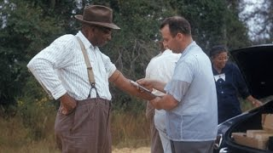
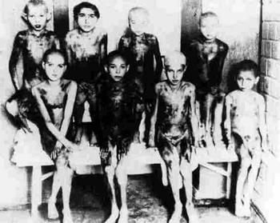
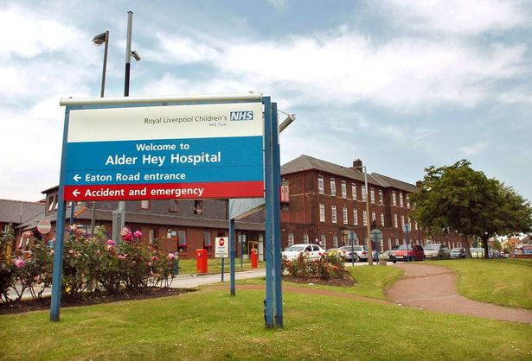
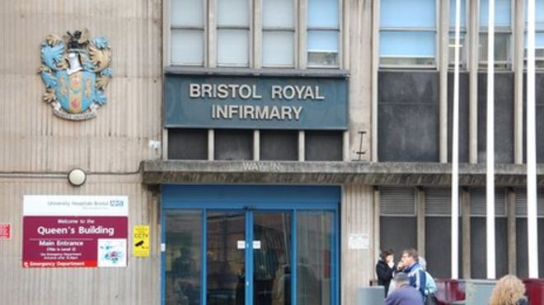
Research Misconduct – Past Lessons
1932 - Tuskegee Syphilis Study
1940s - Nazi Trials
1990s-2000s - Bristol Royal Infirmary
Alder Hey Hospital

Slide 6
Ethics Vs Morals (?)
Morals | Ethics
The beliefs of the individual or group as to what is right or wrong. | The guiding principles which help the individual/ group to decide what is good or bad.
General principles set by a group | Response to a specific situation
Mos which means custom | Ethikos which means character
Social and cultural norms | Individual or Legal and Professional norms
May differ from society to society and culture to culture. | Generally uniform and common
Expressed in the form of general rules and statements. | Is absolute and often ratified by law
Slightly modified from - Sivasubramaniam et al (2021) Int J Educ Integr. https://doi.org/10.1007/s40979-021-00078-6

Slide 7
Ethics governs everything we do in our day-to-day lives
Figure adopted from https://ethics.community/materials/moral-values-and-moral-norms/

Slide 8
Aims of TILT Sabbatical
Main Pillars of Research ethics
Honesty
Integrity
Values
Respect and informed consents
Confidentiality
Fairness
Responsibility
Accountability

Slide 9
Activities that need Ethical Approval
Research that involves human participants
Use of the ‘products’ of human participants
Work that potentially impacts on humans
Research that involves animals
A disclaimer is needed if ethical approval is deemed unnecessary

Slide 10
Situational Ethical Decision making
Links to ethical behaviour – ‘owning actions and their consequences’
Expecting the unexpected! - Always
Be brave - to take the right decision, according to the situation.
Adapting to environmental needs while maintaining ethical principles

Slide 11
Covert observational – Studies in Psychology
The research involved recruiting community represented participants.
Health promotion leaflets were displayed in waiting rooms
Studied the influence of these leaflets in their health related behaviour
Discuss the ethical issues of this study!

Slide 12
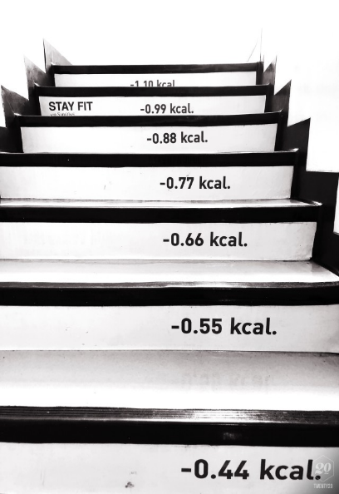
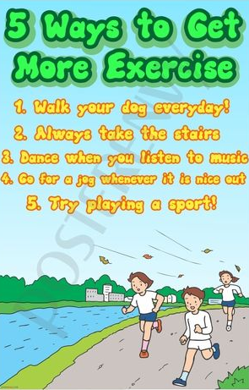
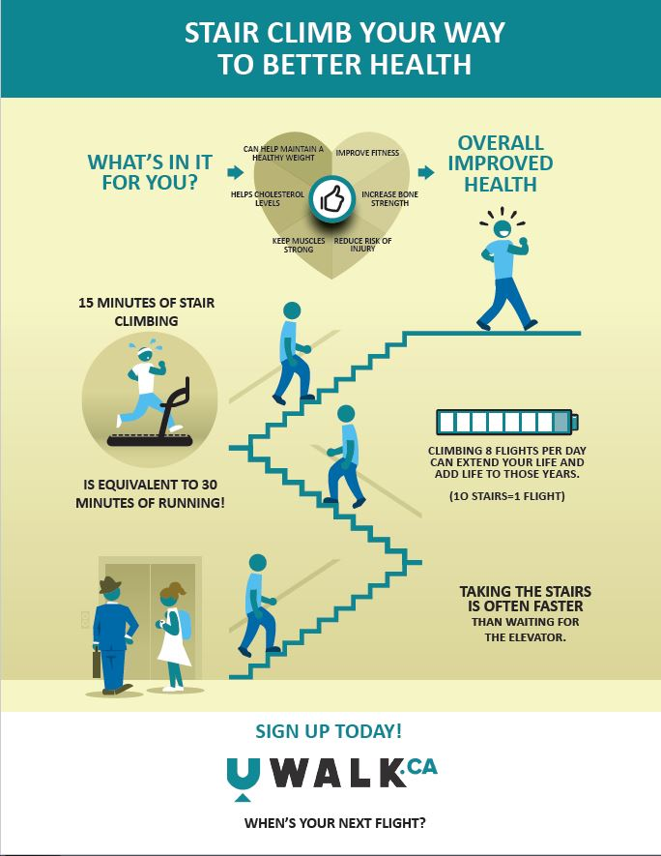
Covert research - Values and volition
Research objective should have strong scientific merits.
Appropriate risk management and harm alleviation should be in place
Avoiding discomfort, anger or objections among participants when revealed
Should protect the dignity and autonomy of participants.

Slide 13
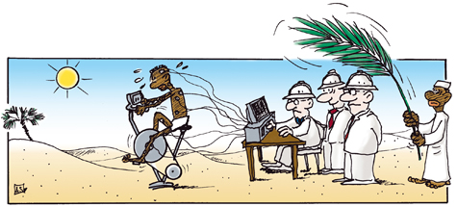
What is Wrong with this research setting?

Slide 14
Situational Ethical decision making

Slide 15
Ethical Case Study 1:
Teacher-student Boundaries
Original Video Adopted from - https://www.youtube.com/watch?v=sQS6jKianYQ

Slide 16
Ethical Case Study 1:
Teacher-student Boundaries
Discuss the ethical issues about this teacher-student relationship
Is it appropriate to communicate with students using their private email addresses and phone numbers?
How might you handle the situation?
https://www.youtube.com/watch?v=sQS6jKianYQ

Slide 17
Ethical Case study 2:
Teacher Behaviours
Original Video Adopted from https://www.youtube.com/watch?v=fGQbLSEPN5w

Slide 18
Ethical Case Study 2:
Teacher Behaviour
Discuss the ethical issues about this teacher behaviour
What are the steps her colleague can take to stop this behaviour?
Are there any guidelines for social media usage for individuals dealing with “vulnerable people”?

Slide 19
Ethical Case study 3:
Parental rights Vs Patient welfare
Original video adopted from https://www.youtube.com/watch?v=7jE7MY4OF6k

Slide 20
Ethical Case study 3:
Parental rights Vs Patient welfare
Who has the right to decide about Alfie’s medical intervention?
Does the decision by the courts justifiable?
Discuss the justifications from the medical experts to remove life support for this baby?

Slide 21
Ethical Case study 4:
Medical Ethics in Clinical setting
Original Video adopted from https://www.youtube.com/watch?v=2D-K2twZwr8

Slide 22
Ethical Case study 4:
Medical Ethics in Clinical setting
Discuss the ethical issues that need attention in each of the following scenes.
Scene 1: The conversation between the Afro-Caribbean patient and the Caucasian doctors
Scene 2: The conversation between the boy and the convict
Scene 3: The conversation between the boy and the Afro-Caribbean doctor
Scene 4: The conversation between the convict and the Caucasian doctor

Slide 23
Ethical Case study 5:
Business ethics (wrong training)
Original Video Adopted from https://www.youtube.com/watch?v=7chfmZ469lE

Slide 24
Ethical Case study 5:
Business ethics (wrong training)
How do you feel about the trainer behaviour?
Do you think the trainee should report this behaviour?
Discuss the implications of trainee reporting this incidence
Discuss the ethical issues that need attention in this clip

Slide 25
Ethical Case study 6:
Research ethics (Rights)
Original video adopted from https://www.youtube.com/watch?v=E1yInC8vQcY

Slide 26
Ethical Case study 6 - Business ethics (wrong training)
Do you think taking additional blood and tissue samples from Mr Moore is justifiable?
Is the university researchers’ decision to transform Mr Moore’s cells into a commercial product justifiable?
Discuss your answers in relation to Human Tissues Act (HTA)

Slide 27
Ethical Case study 7:
Situations involving bullying
Original Video adopted from https://www.youtube.com/watch?v=zm-FjtUklPI

Slide 28
Ethical Case study 7:
Situations involving bullying
How should the teacher handle Morgan's parents requests in the restaurant?
How should the teacher act to defuse cyber-bullying?
What measures can schools take to minimise cyber-bullying
Discuss and justify your answers.

Slide 29
Ethical Case study 8:
Ethics of handling careless mistakes
Original Video adopted from https://www.youtube.com/watch?v=ZwFyASop8nc

Slide 30
Ethical Case study 8:
Ethics of handling careless mistakes
What would do if you are in David’s position?
Should self-interests be considered in this scenario?
What is the remedy for intimidation threats?
Discuss your answers

Slide 31
Ethical Case study 9:
Student seeking advice
Original Video adopted from https://www.youtube.com/watch?v=it4a24xvHuU

Slide 32
Ethical Case study 9:
Student seeking advice
What do you think Coach Carl needs to do?
Do his areas of expertise include mentoring?
What appropriate actions can the coach take?
Discuss your answers

Slide 33
Ethical Case study 10:
Parent-Teacher Relationship
Original Video adopted from https://www.youtube.com/watch?v=cmiaLxCUDkw

Slide 34
Ethical Case study 10:
Parent-Teacher Relationship
Do you think it is appropriate for the department coordinator to be inquisitive about the private life of her staff?
Do you think, David’s newly found relationship is appropriate?
Discuss the pros and cons of teachers establishing relationships with parents of pupils

Slide 35
Aims of TILT Sabbatical
Situational Ethical Decisions need
Pro-active thinking
“Recognizing the Future Moves!”
“Expecting the unexpected!”

